Slide 1
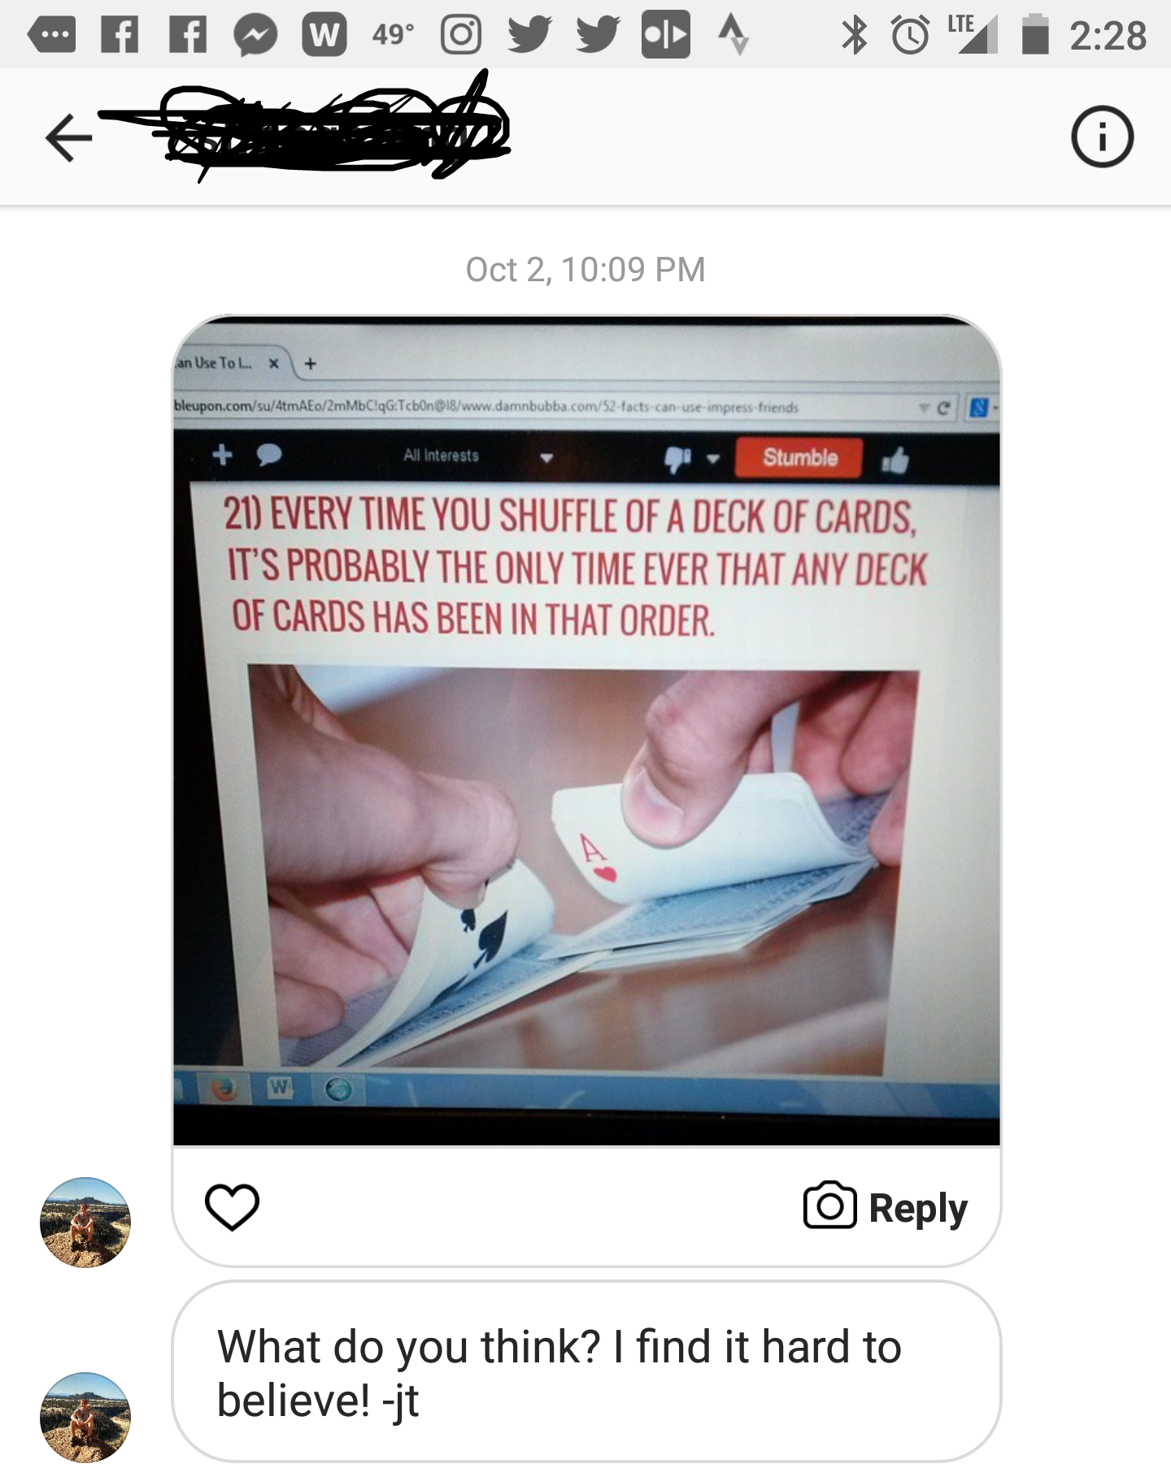
In case we run out of decks: https://www.random.org/playing-cards/

Slide 2
Fundamental Counting Principle!
If one thing can be done a ways, and another sequential thing can be done b ways, then you can do both things in order a*b ways.
(this can be applied to as few as two things, or as many as you need!)

Slide 3
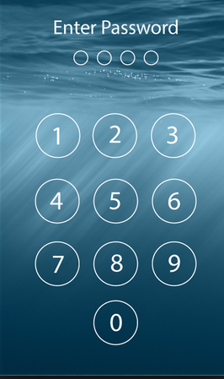
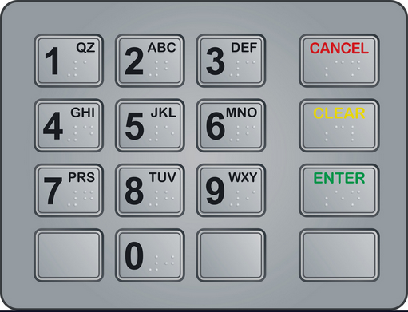

Slide 4
