Slide 1
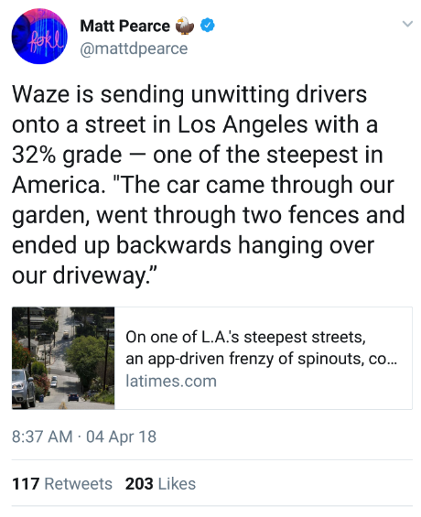

Slide 2
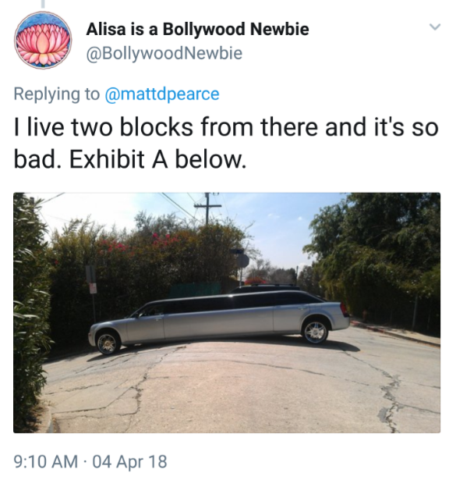
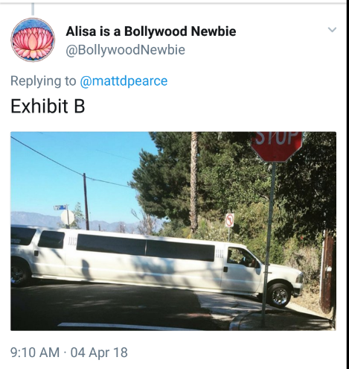

Slide 3
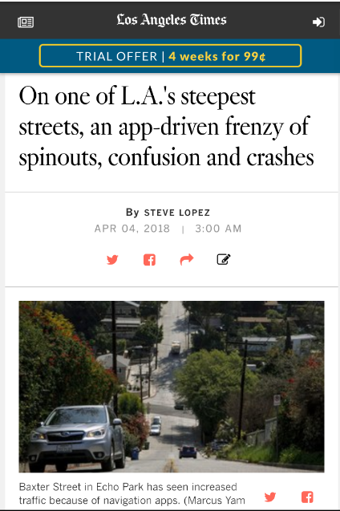
“Nobody could have known, several years ago, that technological progress could make life so complicated in Echo Park.
But along Baxter Street, everyone seems to have a story about the ineptitude of drivers — following directions from navigation apps — who can't seem to handle one of the steepest inclines in Los Angeles.
‘Rain is a huge problem. People start skidding and spinning. We had our garden wall knocked down twice, and my wife's car got hit in our own driveway. I've seen five or six cars smash into other cars, and it's getting worse.’
Baxter ranks as the third-steepest street in Los Angeles with a 32% grade, behind 28th Street in San Pedro (33.3%) and Eldred Street in Mount Washington (33%)."
http://www.latimes.com/local/california/la-me-lopez-echo-park-traffic-20180404-story.html

Slide 4
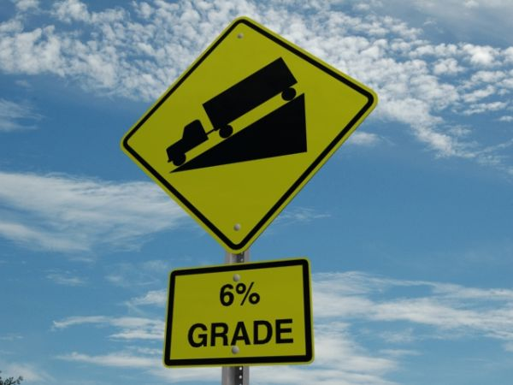

Slide 5
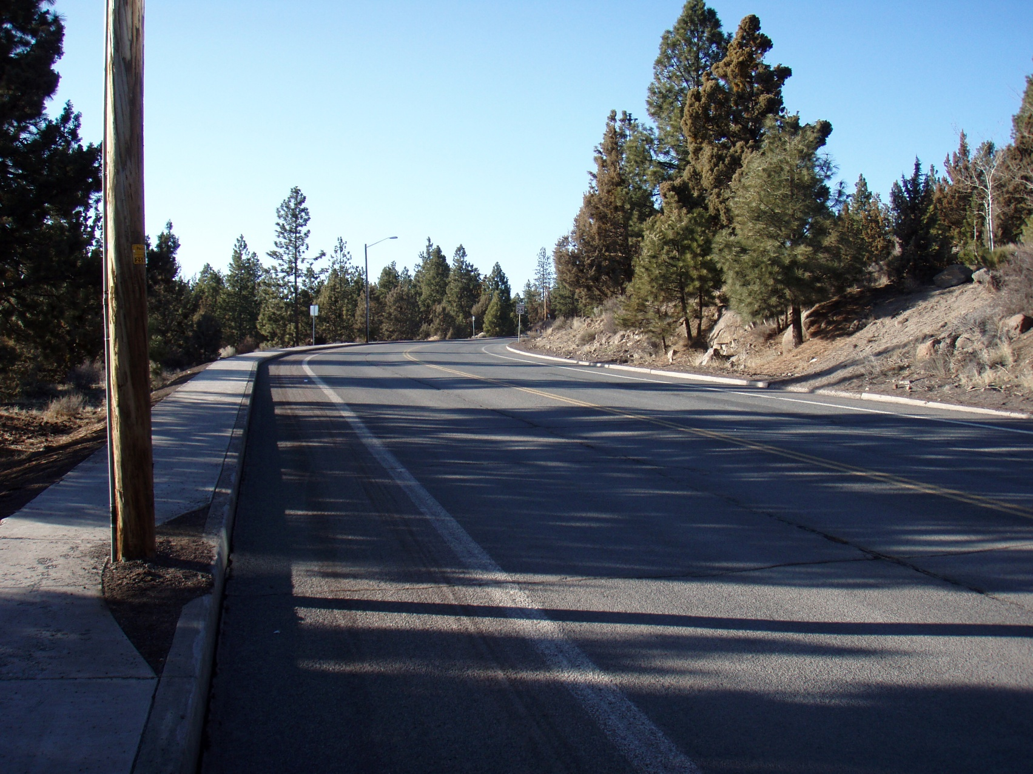
College Way (6%...angle?)

Slide 6
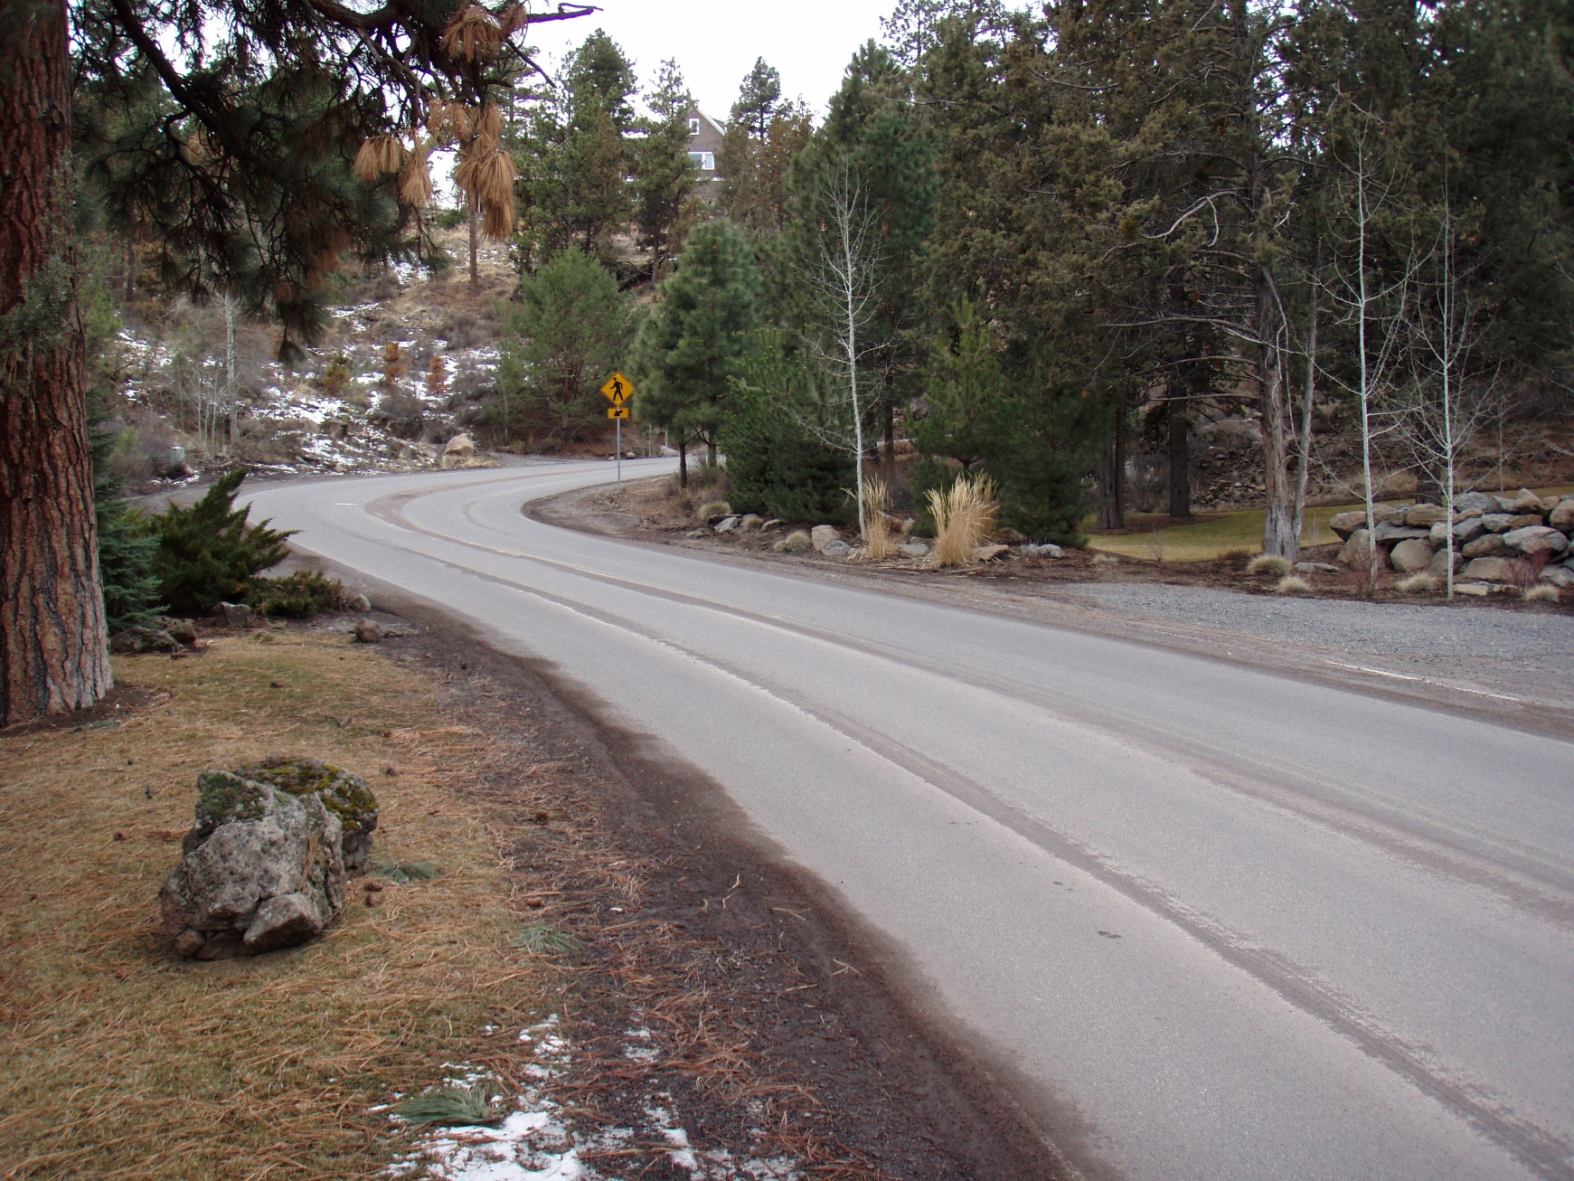
Archie Briggs
Road (16.7%)
(angle?)

Slide 7
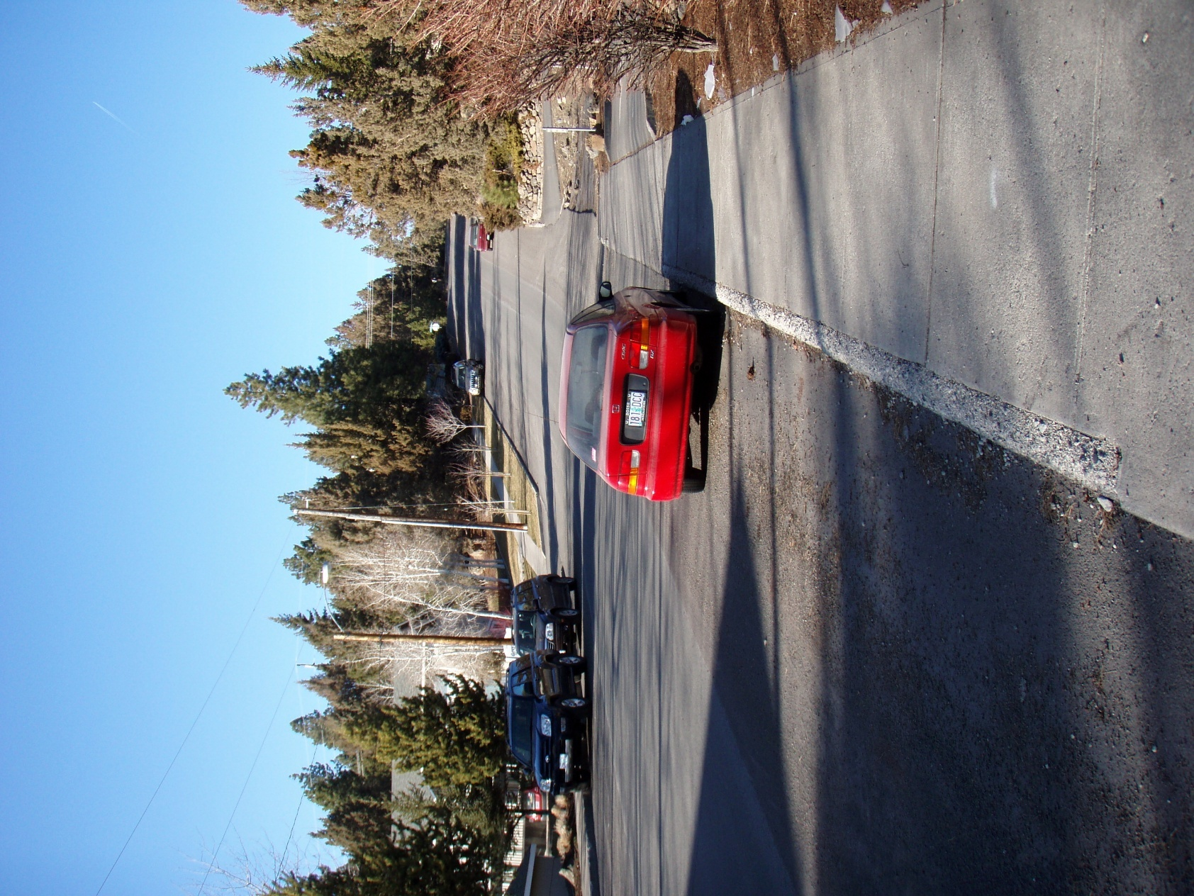
Juniper Street (17.7%)

Slide 8
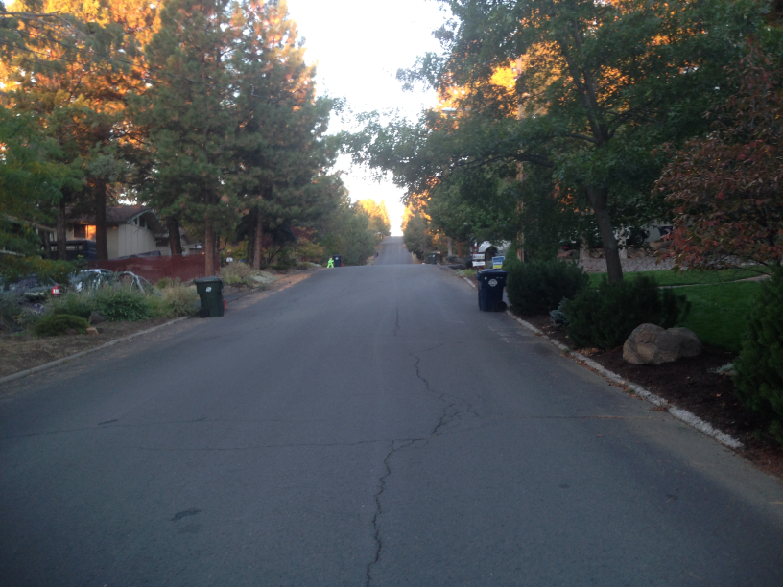

Slide 9
Iowa Street (15%)

Slide 10
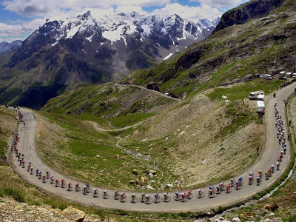
Galiber Pass (7.1%)

Slide 11
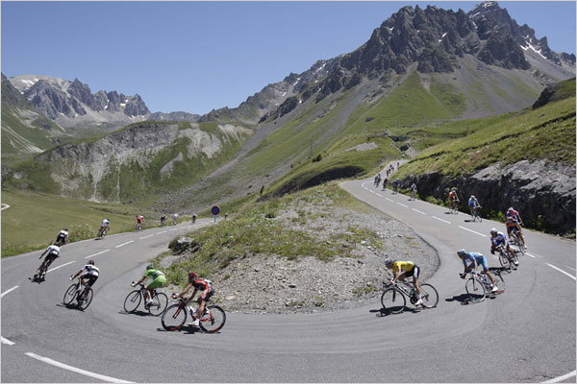
L’Alpe De Huez (8%)

Slide 12
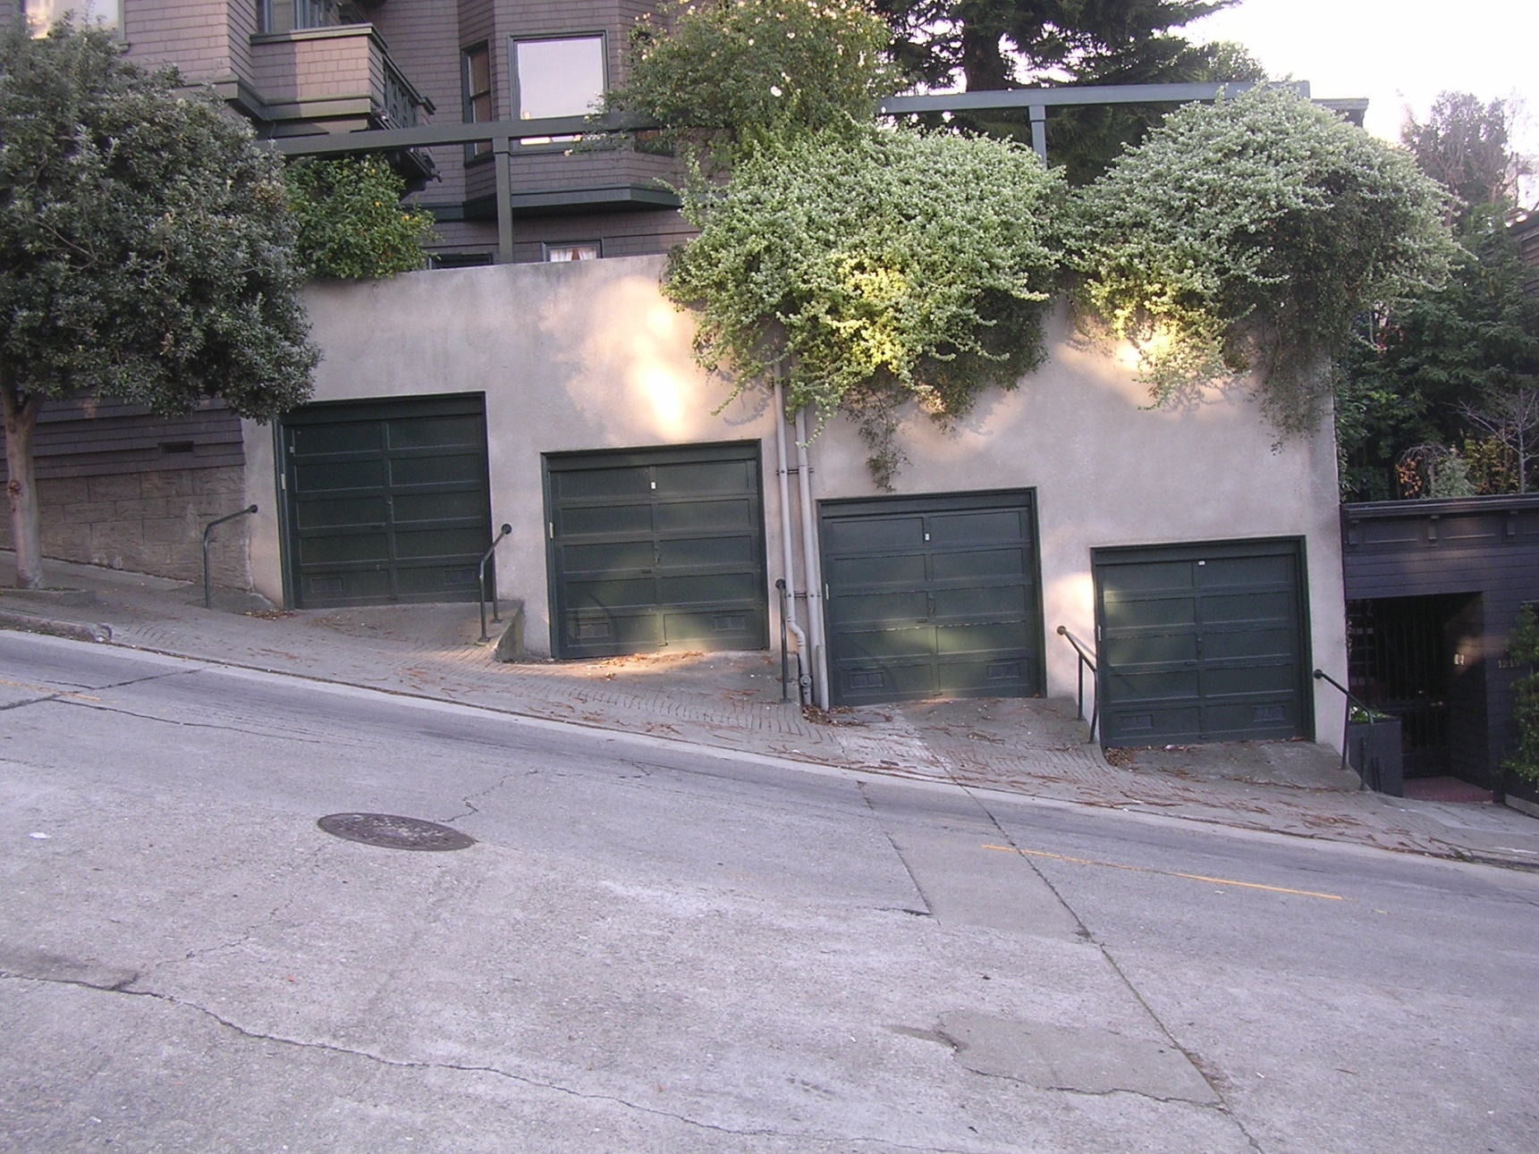
San Francisco (random street...~18%-20%)

Slide 13
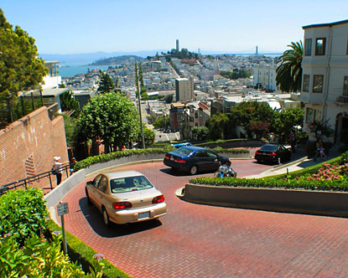
Lombard Street (28.7%)

Slide 14
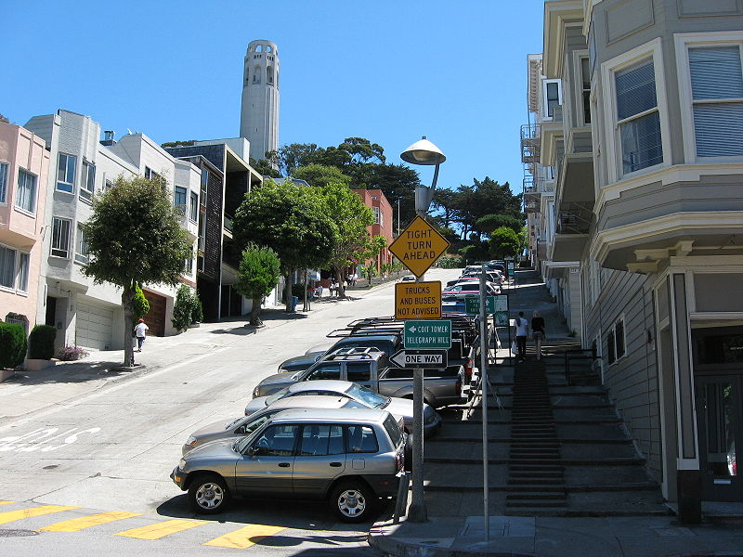
Filbert Street (31.3%)

Slide 15
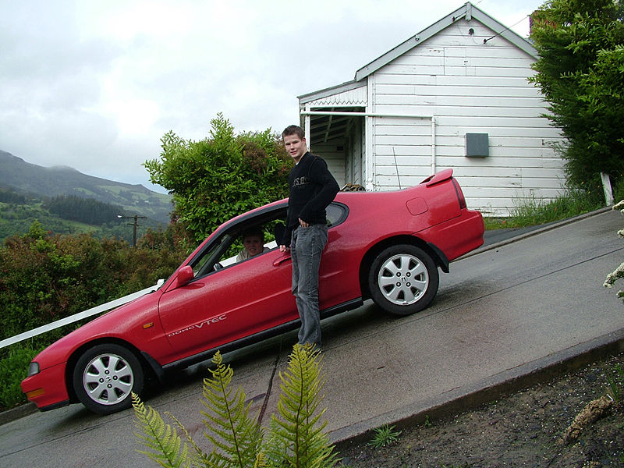
Baldwin Street, NZ (35%)

Slide 16
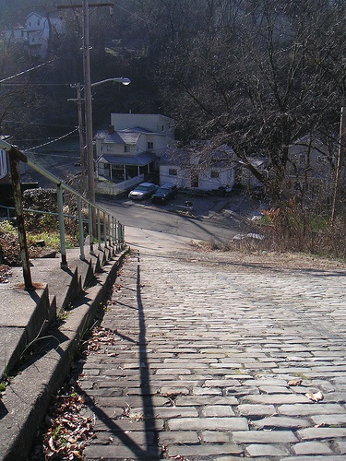
Canton Avenue, Pittsburgh (37%)

Slide 17
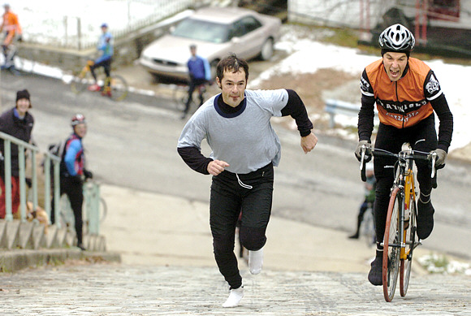

Slide 18
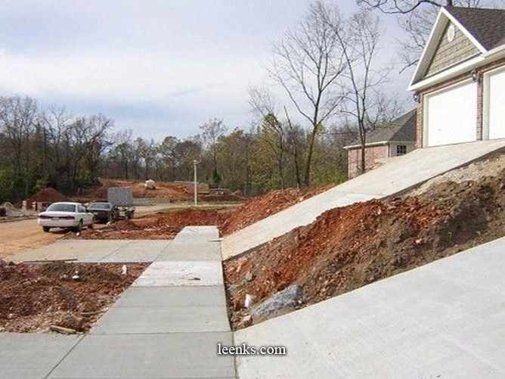
Somewhere in Florida (40%)

Slide 19
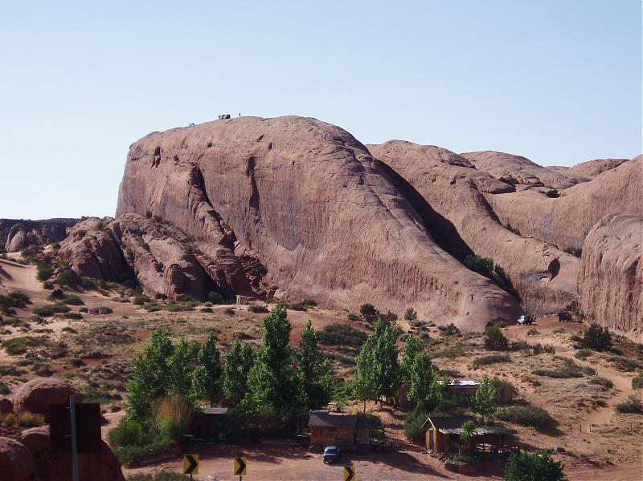

Slide 20
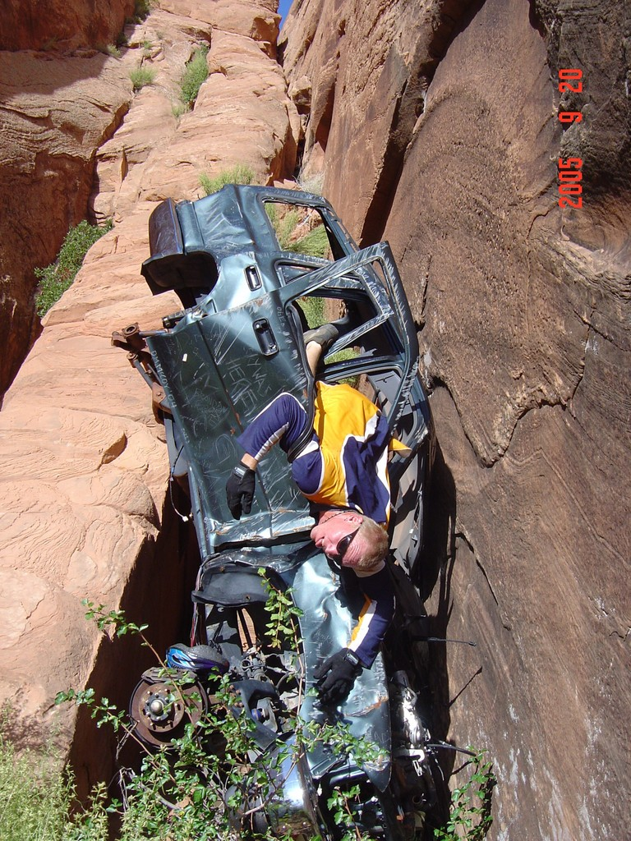
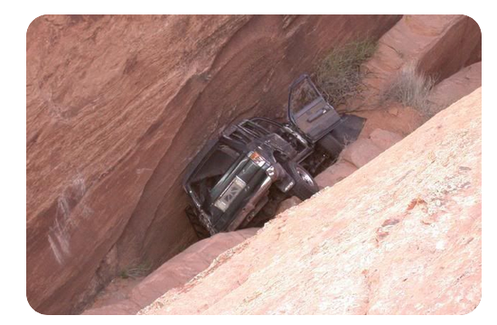
Jeep Crawl
Uh, Oh…
Let’s do our first in-class quiz!

Slide 21
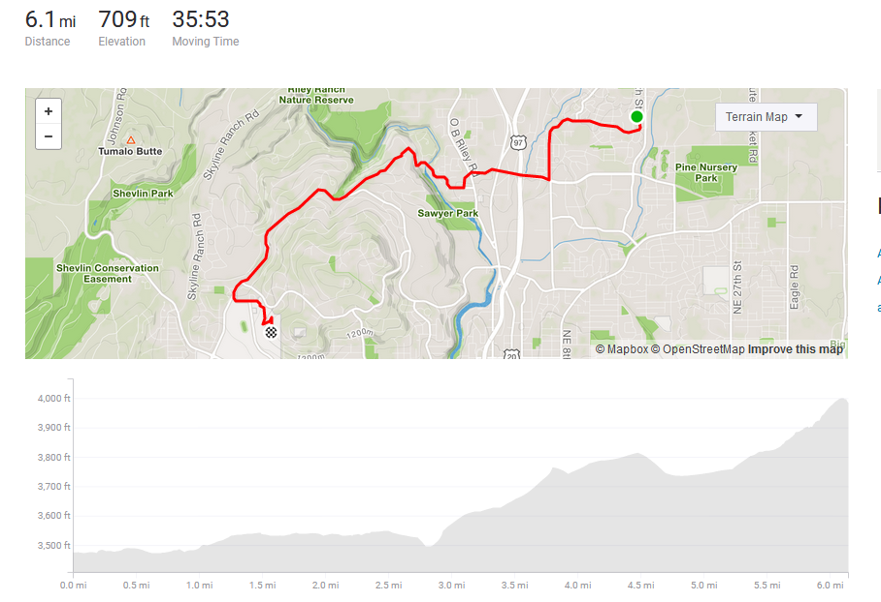

Slide 22
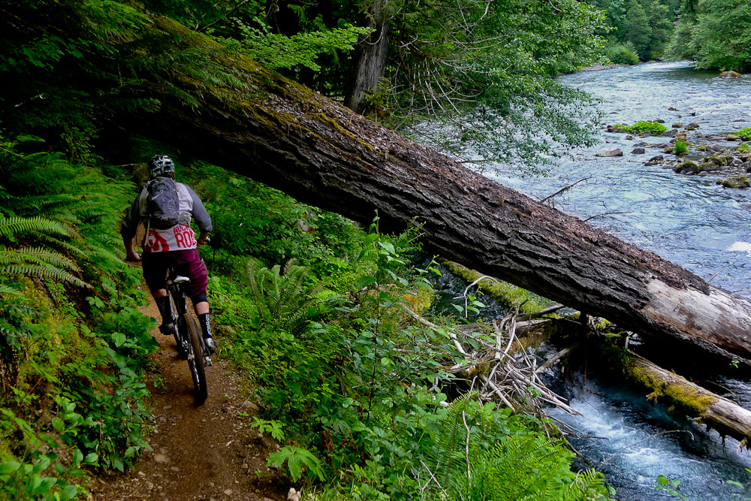
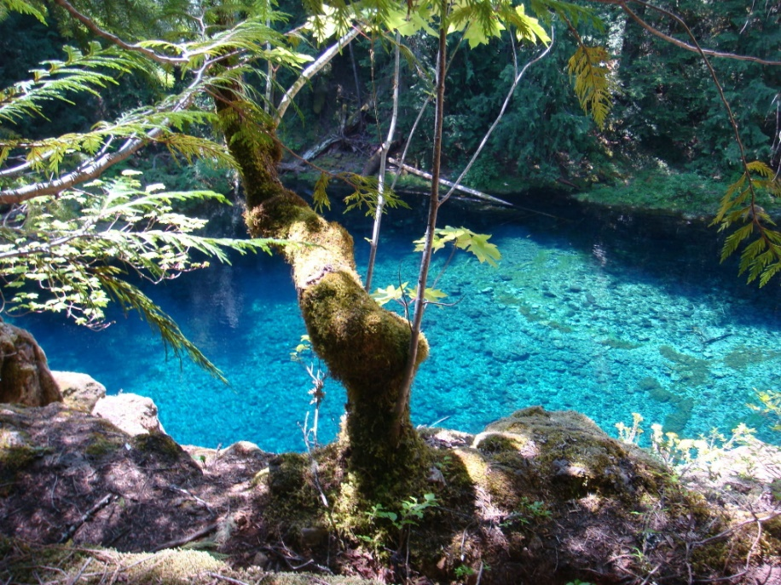
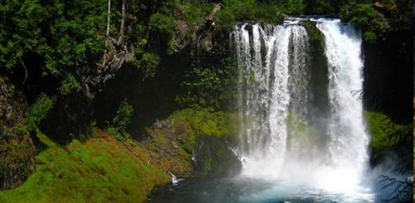
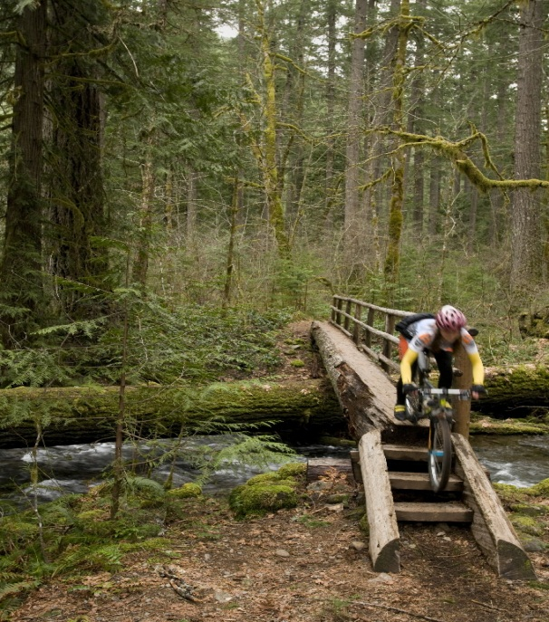

Slide 23
