Slide 1
“There are lies,
there are damned lies,
and there are
“
- Mark Twain

Slide 3
What are “statistics?”
it up!
Let’s brainstorm…

Slide 4
What are some ways
to display statistics?
0 | 5 | 2 | 0 | 5 | 3 | 3 | 7 | 0 | 7 | 6 | 5 | 0 | 7
3 | 4 | 0 | 0 | 4 | 0 | 4 | 2 | 4 | 4 | 8 | 3 | 0 | 5 | 8
0 | 3 | 10 | 9 | 10 | 6 | 8 | 9 | 0 | 0 | 9 | 3 | 8 | 4

Slide 5
What are some ways
to display statistics?
Number of Quizzes Left To Do! (F21) | Freq | % freq
0 | 10 | 0.23
1 | 0 | 0.00
2 | 2 | 0.05
3 | 9 | 0.21
4 | 8 | 0.19
5 | 2 | 0.05
6 | 1 | 0.02
7 | 1 | 0.02
8 | 4 | 0.09
9 | 4 | 0.09
10 | 2 | 0.05
What’s the modal number of quizzes left to do?

Slide 6
What are some ways
to display statistics?
Number of Quizzes Left To Do! (F21) | Freq | % freq
0 | 10 | 0.23
1 | 0 | 0.00
2 | 2 | 0.05
3 | 9 | 0.21
4 | 8 | 0.19
5 | 2 | 0.05
6 | 1 | 0.02
7 | 1 | 0.02
8 | 4 | 0.09
9 | 4 | 0.09
10 | 2 | 0.05
What’s the median number of quizzes left to do?

Slide 7
What are some ways
to display statistics?
Number of Quizzes Left To Do! (F21) | Freq | % freq
0 | 10 | 0.23
1 | 0 | 0.00
2 | 2 | 0.05
3 | 9 | 0.21
4 | 8 | 0.19
5 | 2 | 0.05
6 | 1 | 0.02
7 | 1 | 0.02
8 | 4 | 0.09
9 | 4 | 0.09
10 | 2 | 0.05
What’s the average number of quizzes left to do?

Slide 8
What are some ways
to display statistics?
Number of Quizzes Left To Do! (F21) | Freq | % freq
0 | 10 | 0.23
1 | 0 | 0.00
2 | 2 | 0.05
3 | 9 | 0.21
4 | 8 | 0.19
5 | 2 | 0.05
6 | 1 | 0.02
7 | 1 | 0.02
8 | 4 | 0.09
9 | 4 | 0.09
10 | 2 | 0.05
How many total quizzes still need to be turned in for everyone to get their 10 done?

Slide 9
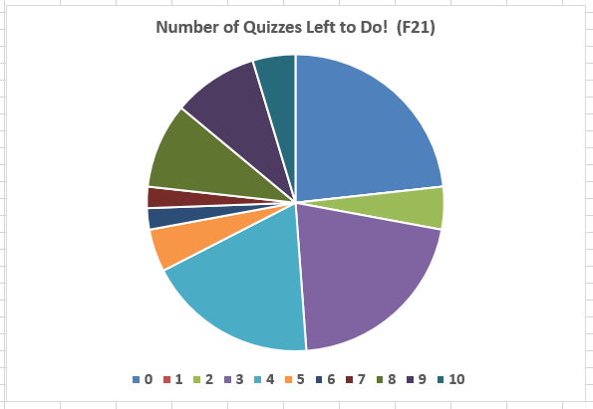
What are some ways
to display statistics?
1. Pie Charts

Slide 10
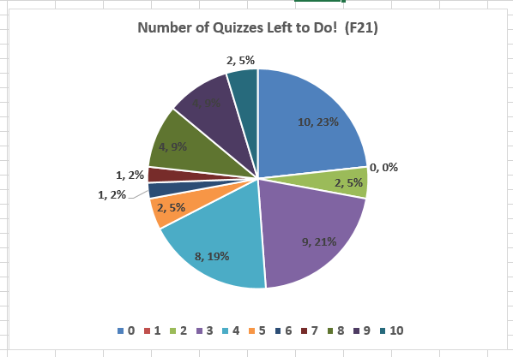
What are some ways
to display statistics?
1. Pie Charts

Slide 11
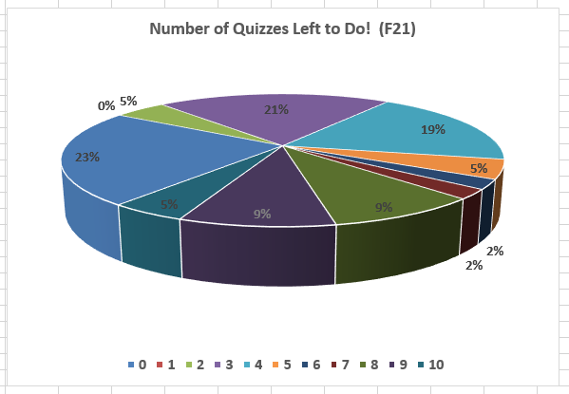
What are some ways
to display statistics?
1. Pie Charts

Slide 12
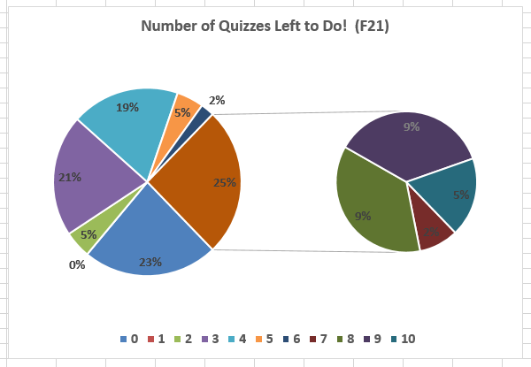
What are some ways
to display statistics?
1. Pie Charts

Slide 13
What are some ways
to display statistics?
1. Pie Charts
When making pie charts:
DO!
Make sure your categories are meaningful!
Make sure your categories are mutually exclusive!
Make sure your graph speaks for itself (clear fonts and sizes, crisp colors, good title and legend)
DON’T!
Use 3 – D Pie Charts! (IMHO)
Use those “Breakout” slices! (IAHO)

Slide 14
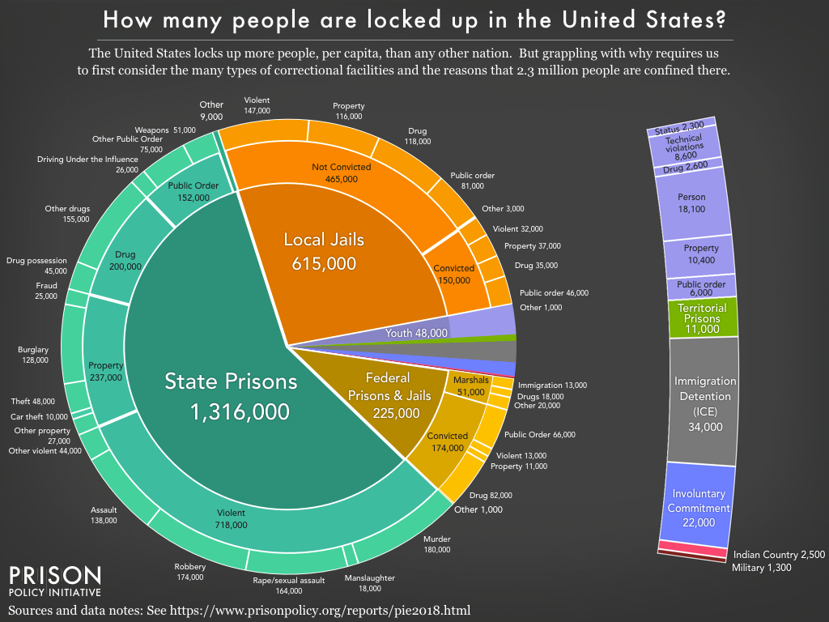
What are some ways
to display statistics?
1. Pie Charts

Slide 15
What are some ways
to display statistics?
1. Pie Charts

Slide 16
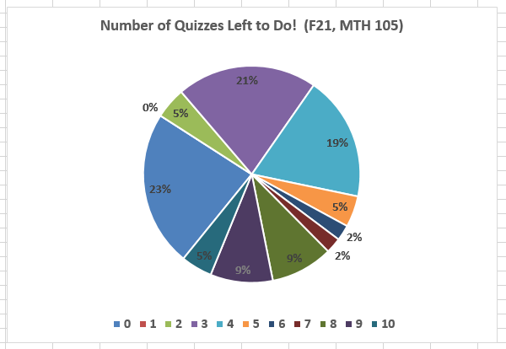
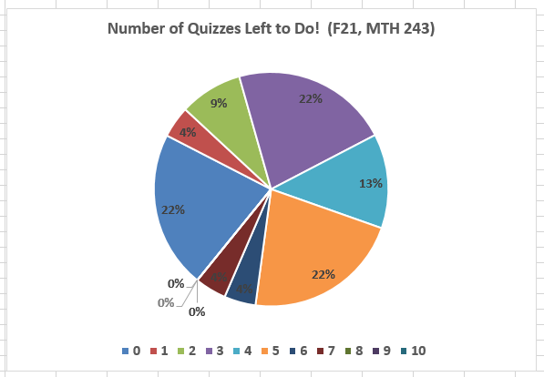
What are some ways
to display statistics?
1. Pie Charts

Slide 17
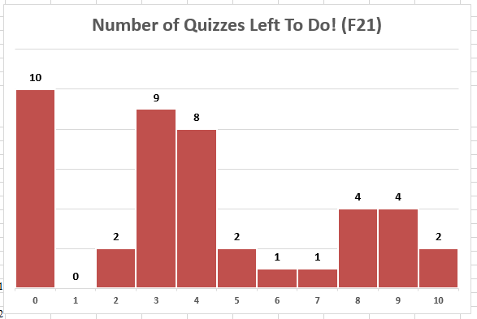
What are some ways
to display statistics?
2. Bar Graphs (AKA, “Bar Charts”)

Slide 18
What are some ways
to display statistics?
2. Bar Graphs (AKA, “Bar Charts”)

Slide 19
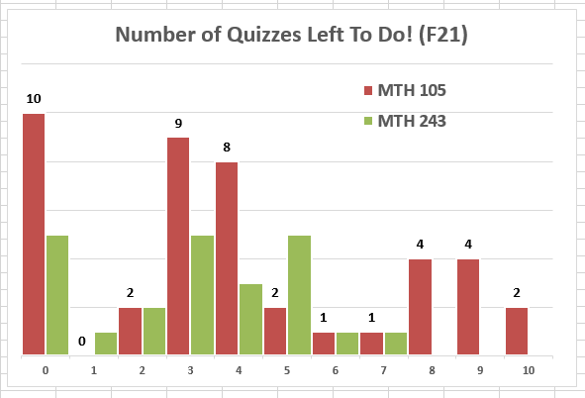
What are some ways
to display statistics?
2. Bar Graphs (AKA, “Bar Charts”)

Slide 20
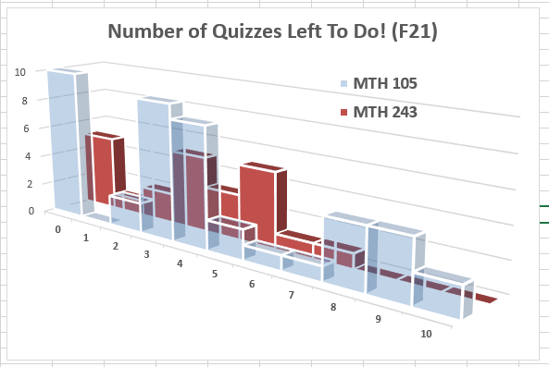
What are some ways
to display statistics?
2. Bar Graphs (AKA, “Bar Charts”)

Slide 21
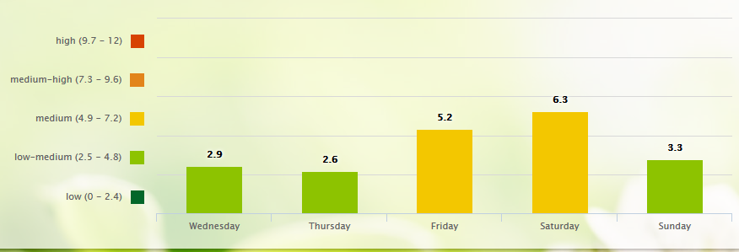
https://www.pollen.com/forecast/extended/pollen/97701

Slide 22
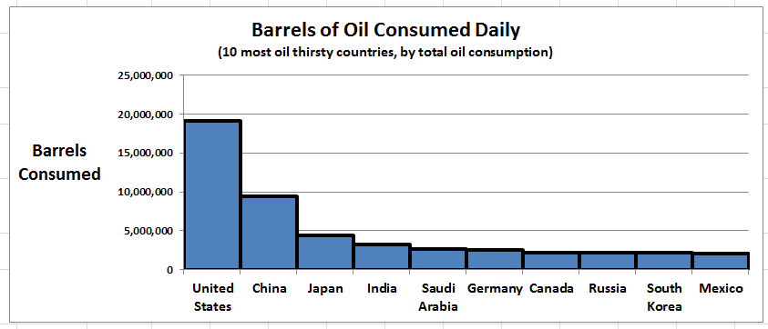
What are some ways
to display statistics?
2. Bar Graphs (AKA, “Bar Charts”)
Source: http://www.indexmundi.com/g/r.aspx?v=91

Slide 23
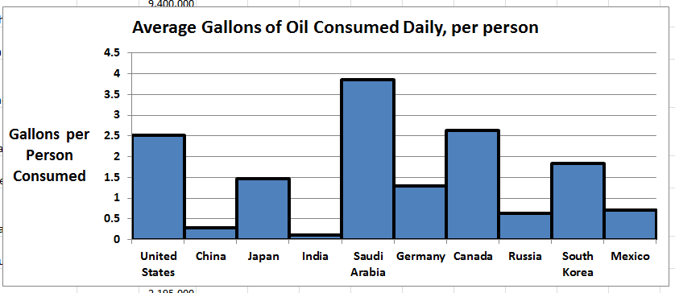
What are some ways
to display statistics?
2. Bar Graphs (AKA, “Bar Charts”)

Slide 24
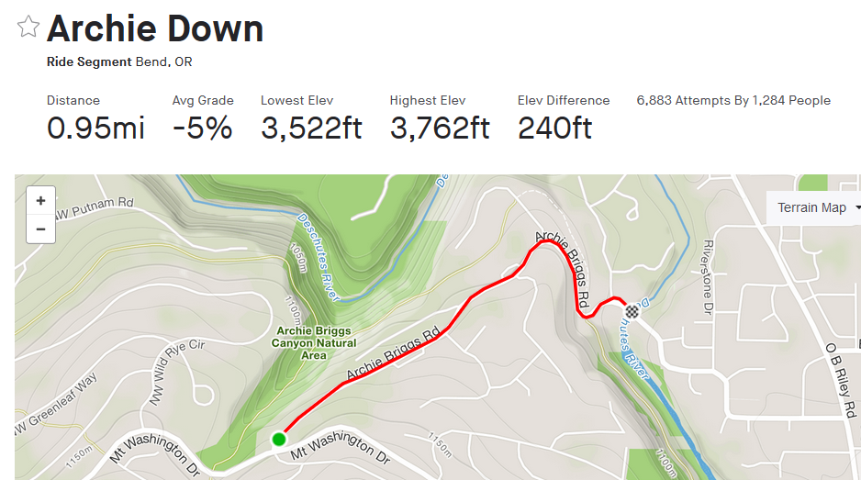
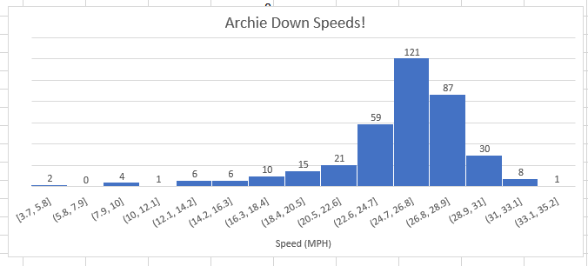
What are some ways
to display statistics?
2. Bar Graphs (AKA, “Bar Charts”)

Slide 25
What are some ways
to display statistics?
2. Bar Graphs (AKA, “Bar Charts”)
When making bar graphs:
DO!
Make sure your categories are meaningful!
Make sure your categories are mutually exclusive!
Make sure your graph speaks for itself (clear fonts and sizes, crisp colors, good title, axes labeled if necessary)!
(meh) Make the bars touch!
DON’T!
LET YOUR Y – AXIS START AT SOMETHING OTHER THAN ZERO!!! (why? Let’s take a look!)

Slide 27
Anything wrong with this graph?

Slide 28
Always start this axis at zero!!!

Slide 29
What are some ways
to display statistics?
3. Line Graphs (often Time - Series)

Slide 30
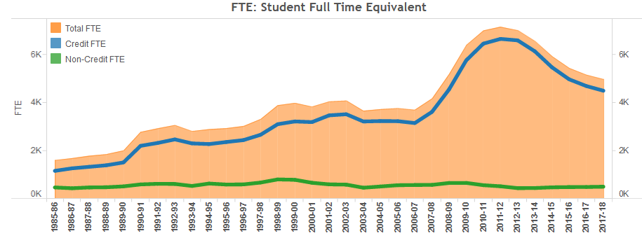
What are some ways
to display statistics?
3. Line Graphs (often Time - Series)
https://www.cocc.edu/departments/institutional-effectiveness/enrollment-reports/historical-enrollment.aspx

Slide 31
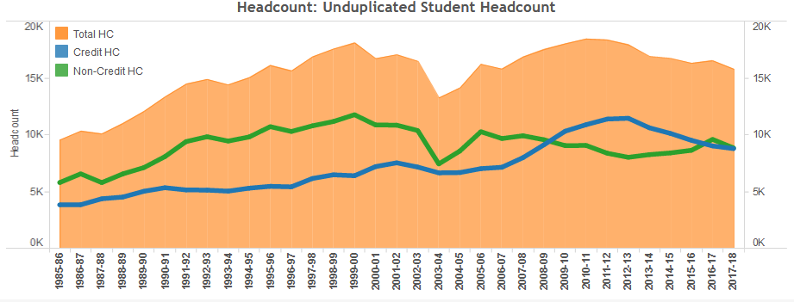
What are some ways
to display statistics?
3. Line Graphs (often Time - Series)
https://www.cocc.edu/departments/institutional-effectiveness/enrollment-reports/historical-enrollment.aspx

Slide 32
What are some ways
to display statistics?
3. Line Graphs (often Time - Series)

Slide 33
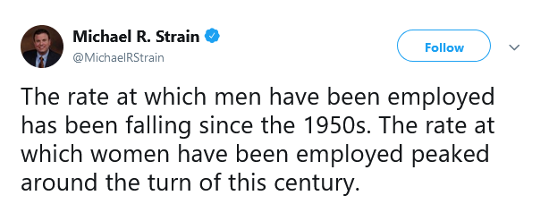
What are some ways
to display statistics?
3. Line Graphs (often Time - Series)

Slide 34
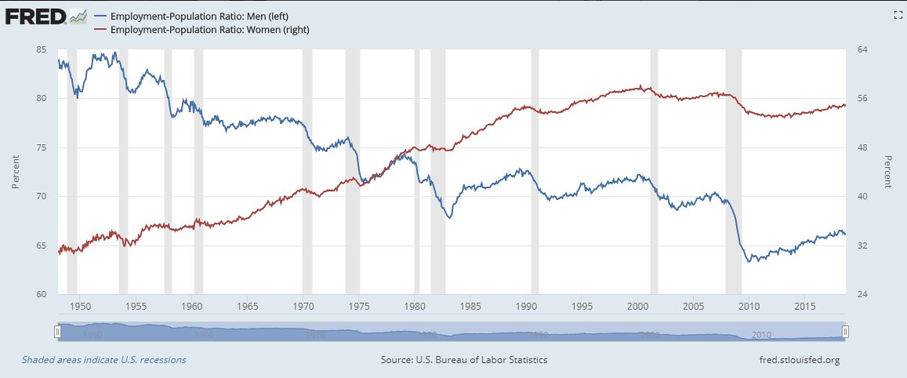
What are some ways
to display statistics?
3. Line Graphs (often Time - Series)

Slide 35
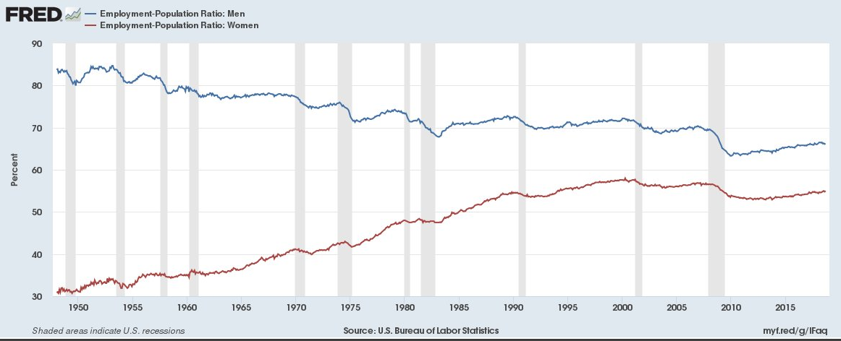
What are some ways
to display statistics?
3. Line Graphs (often Time - Series)

Slide 36
What are some ways
to display statistics?
3. Line Graphs (often Time - Series)
When making line graphs:
DO!
Make sure your categories are meaningful!
Make sure your categories are mutually exclusive!
Make sure your graph speaks for itself (clear fonts and sizes, crisp colors, good title, axes labeled if necessary)!
Be careful with multiple vertical- axes!
DON’T!
LET YOUR Y – AXIS START AT SOMETHING OTHER THAN ZERO!!! (why?)
Ignore the Margin Of ERROR!!!
Huh?

Slide 37
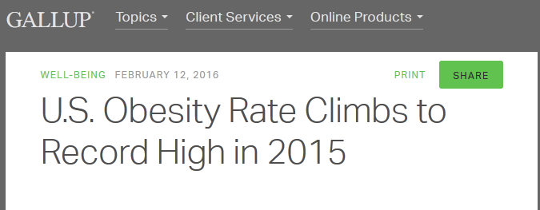
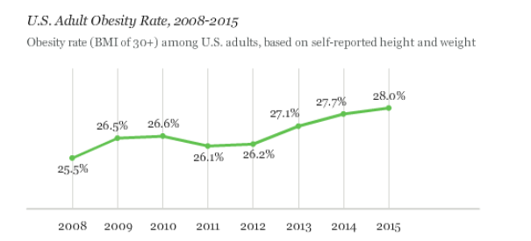
Please find this report online!!!

Slide 38
Any issues with the data?
If you’re interested: http://stateofobesity.org/adult-obesity/

Slide 39
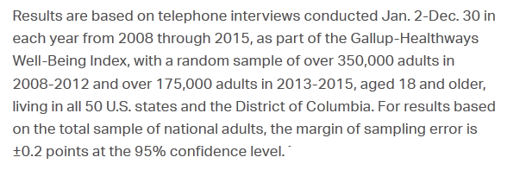
Let’s check the rest of those MOE’s…

Slide 40
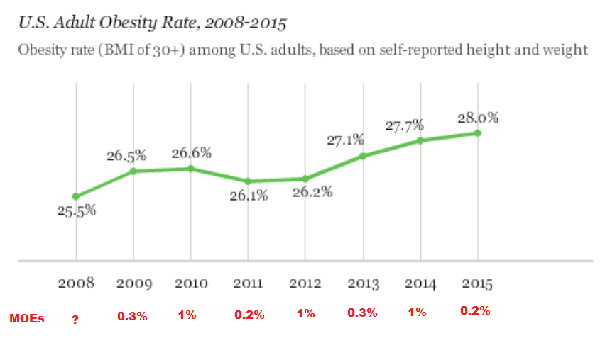
Now let’s USE those MOEs…

Slide 41
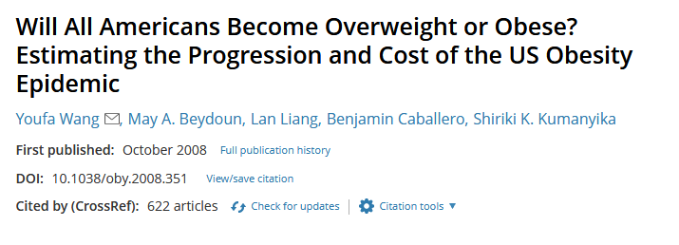
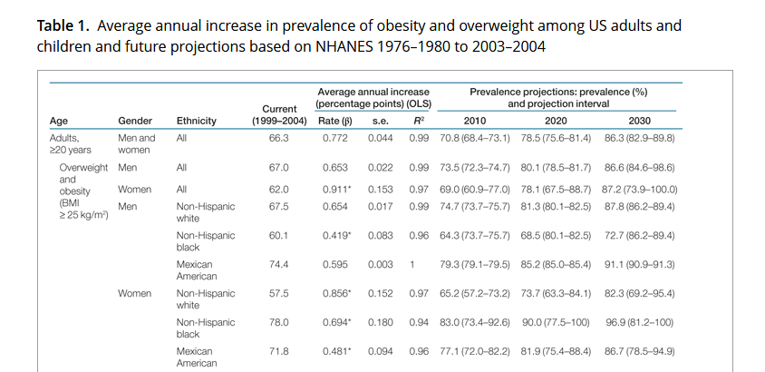

Slide 43
Statisticians want to know measures of populations they’re studying. These measures are called parameters.
Unfortunately, the only way to get the value of a parameter is to do a census (“count or measure everyone”).

Slide 44
So instead, statisticians do a random sample of the population. From that sample, they arrive at statistics.
On average, the statistic’s value will be close to the parameter.
But what does “close” mean?

Slide 45
Margins of Error (MOEs) must be added (and subtracted) to/from any sample statistic to help alleviate sampling error.
On average, it’ll be off by no more than a margin of error.
Let’s do an in – class quiz!

