Slide 1
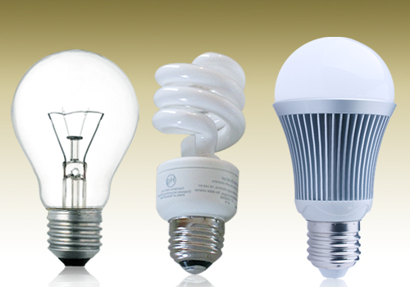
Compact
Fluorescent
(CFL)
Light Emitting
Diode (LED)
Incandescent

Slide 2
$0.50 each
$3 each
$5 each
(60 Watt or equivalent – per 1000bulbs.com)

Slide 3
$0.006/hr
$0.0014/hr
$0.001/hr
(2015 Bend power rates over 25,000 hours)

Slide 4
What’s the better buy based on total cost?
(purchase price and power used)
A gift for you…

Slide 5
Other things to consider!

Slide 6
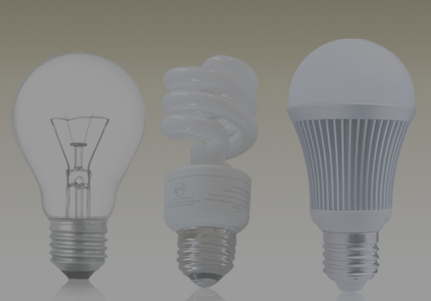
Other things to consider!
Lifespan of bulbs!
INC ~1200 hours
CFL: ~8000 hours
LED ~50,000 hours
Hg, Pb, Ni, Cu…
Price over time

Slide 7
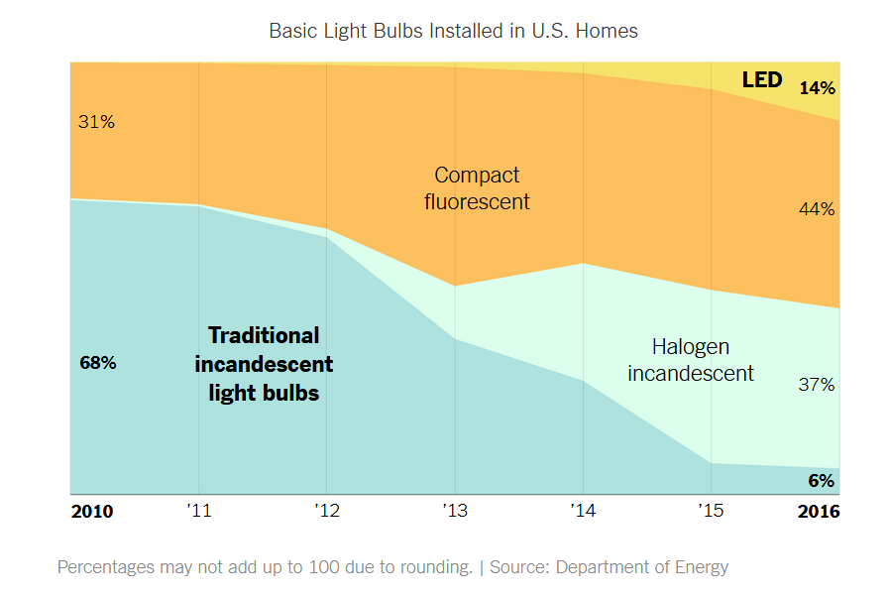
https://www.nytimes.com/interactive/2019/03/08/climate/light-bulb-efficiency.html

Slide 8
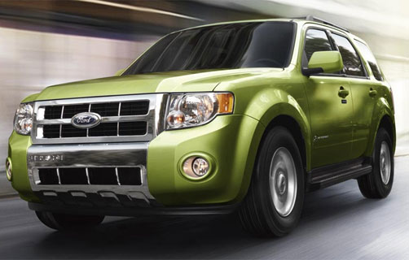
Time to go used car shopping!

Slide 9
2012 Ford Escape…Kelley’s Blue Book Facts and figures:
XLS (V-6) option: $13322, 23 MPG (city)
Hybrid option: $19560, 34 MPG (city)
Which do we buy?

Slide 10
Other things to consider!
Some insurances (ex., Farmer’s, Traveler’s) give discounts for hybrid vehicles.
Some insurances also give hybrid owners “Safe driver” status! Why? Who knows.
What if the batteries run out? Not to worry: https://www.edmunds.com/fuel-economy/the-real-costs-of-owning-a-hybrid.html

