Slide 1
Go ahead and open up the “Braking Distance” Excel spreadsheet.
Take a few moments to insert the perception reaction distances and both braking
distances (dry and icy pavement) into the spreadsheet!
Now let’s create a scatterplot of these data!
(A “scatterplot” is a graph that allows you to see interplay (“correlation”) between two variables)
What pattern appears to exist between braking distances and speed?
And, more importantly…
WHY?

Slide 2
What is “correlation?”
it up!
Let’s hear some ideas!
Let’s brainstorm…

Slide 3
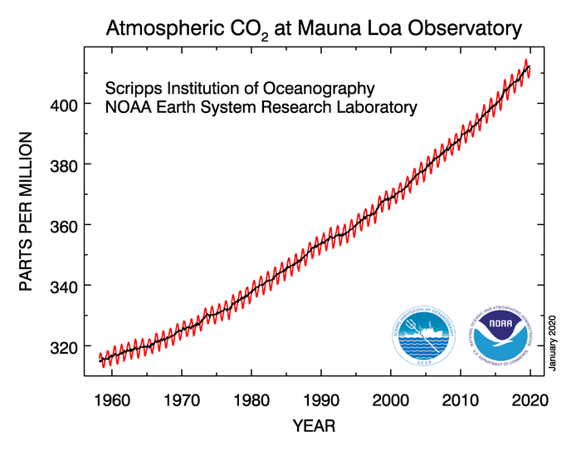
Positive Correlation: “as one variable
goes up, the other one trends up, too!”
(or, the reverse – as one goes down, the other goes down, too)
Source: Earth System Research Laboratory (Global Research Division)

Slide 4
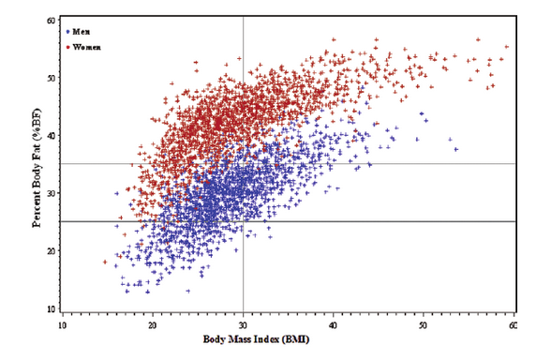
Positive Correlation:
(slightly more messy, but also more realistic)
Source: Android Adiposity and Lack of Moderate and Vigorous Physical Activity
Are Associated With Insulin Resistance and Diabetes in Aging Adults (Peterson et. al.)

Slide 5
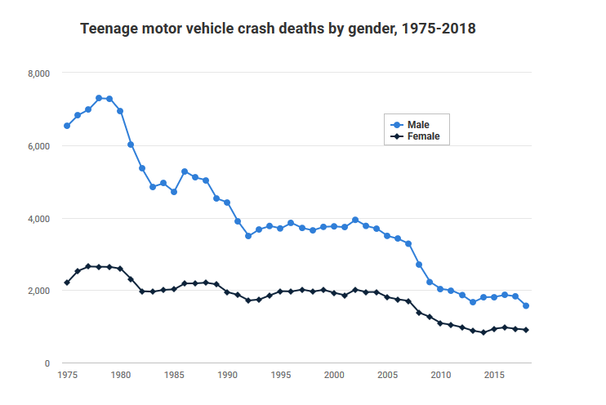
Negative Correlation: “as one variable
goes up, the other one trends down.”
(or, the reverse)
Source:
https://www-fars.nhtsa.dot.gov/Main/index.aspx

Slide 6
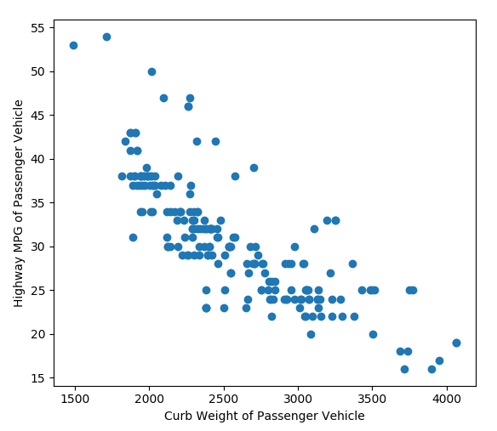
Negative Correlation:
(again, slightly more messy, but also more realistic)
Source: The Automobile Data Set, UC Irvine ML Repository

Slide 7
Is there a Correlation?

Slide 8
Is there a Correlation?
Source: The Joint Use of Standardized Test Scores and High School Grade Point Average for Predicting Success at Community Colleges (Westrick)

Slide 9
Is there a Correlation?
(let’s try one ourselves…open up the “Mystery Data” sheet from the resources page of the syllabus!)

Slide 10
Let’s play Moneyball!

