Slide 1
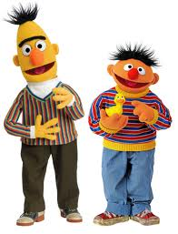
First test scores for two students:
Ernie: 80, 81, 83, 79, 82
Bert: 68, 82, 94, 61, 100

Slide 2
Let’s play with some data
(and learn some Excel stuff)!
Weight Loss
Excel Commands!
Excel Calculator!
How to use that STDEV?
Hourglass Times (thanks, Monte!)
Emails
WHAT THE HELL
YOU THINK I’M GONNA PUT THAT IN YOUR DAMNED CALCULATOR

Slide 3
The takeaway about sample standard deviation “s”
Only meaningful when paired with an average
And only trustworthy when data is roughly bell- shaped (why?)
Average distance between average and sample data
When s is “big” – data is highly varied (scattered)
When s is “small” – data is highly consistent (clumped)

