Slide 2
Weights of 100 randomly selected 2 year old white American males (in pounds)
24 | 31 | 29 | 29 | 25 | 27 | 28 | 27 | 26 | 25
26 | 29 | 31 | 26 | 29 | 30 | 29 | 29 | 20 | 28
20 | 21 | 27 | 31 | 30 | 28 | 29 | 33 | 31 | 29
27 | 28 | 29 | 28 | 31 | 28 | 31 | 27 | 29 | 31
29 | 25 | 27 | 30 | 29 | 30 | 27 | 24 | 29 | 28
26 | 26 | 30 | 31 | 29 | 30 | 29 | 29 | 23 | 30
31 | 29 | 30 | 22 | 24 | 25 | 27 | 30 | 26 | 24
25 | 29 | 28 | 31 | 25 | 22 | 27 | 28 | 26 | 26
27 | 31 | 29 | 20 | 23 | 28 | 25 | 22 | 24 | 24
25 | 31 | 24 | 31 | 31 | 25 | 27 | 28 | 28 | 29

Slide 3
Weights of 100 randomly selected 2 year old white American males (in pounds)

Slide 4
So, Max is in the 80th percentile for his weight, because, at 31 pounds, he weighed more than 80% of 2 – year old white American boys.
In general, a percentile is the proportion of data that a given point exceeds.

Slide 5
Sometimes, to visualize these easier, folks will use cumulative frequency histograms!

Slide 6
...or an ogive.

Slide 7
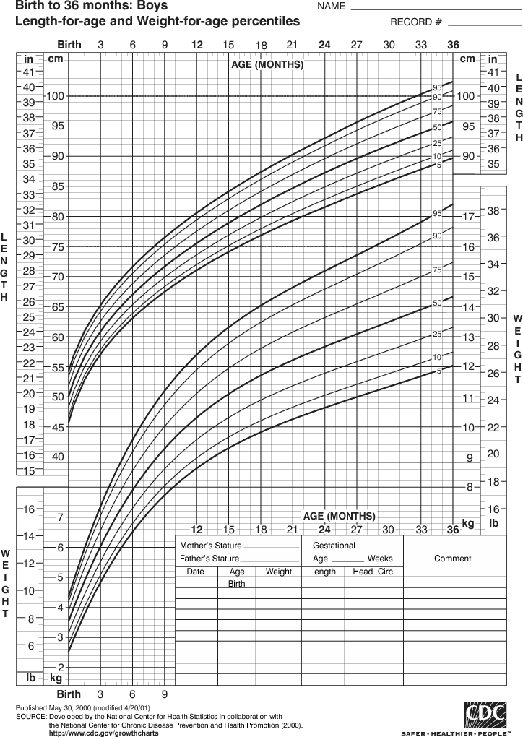
An ogive you
might see
one day
(or maybe
already have!)

Slide 8
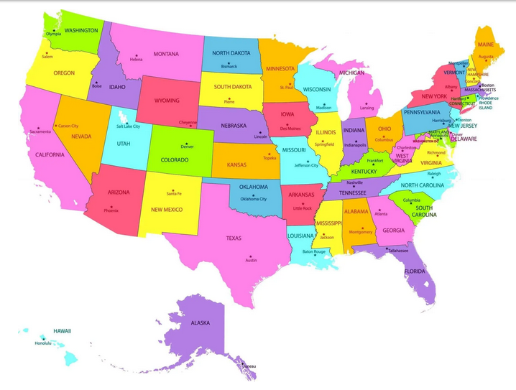

Slide 9
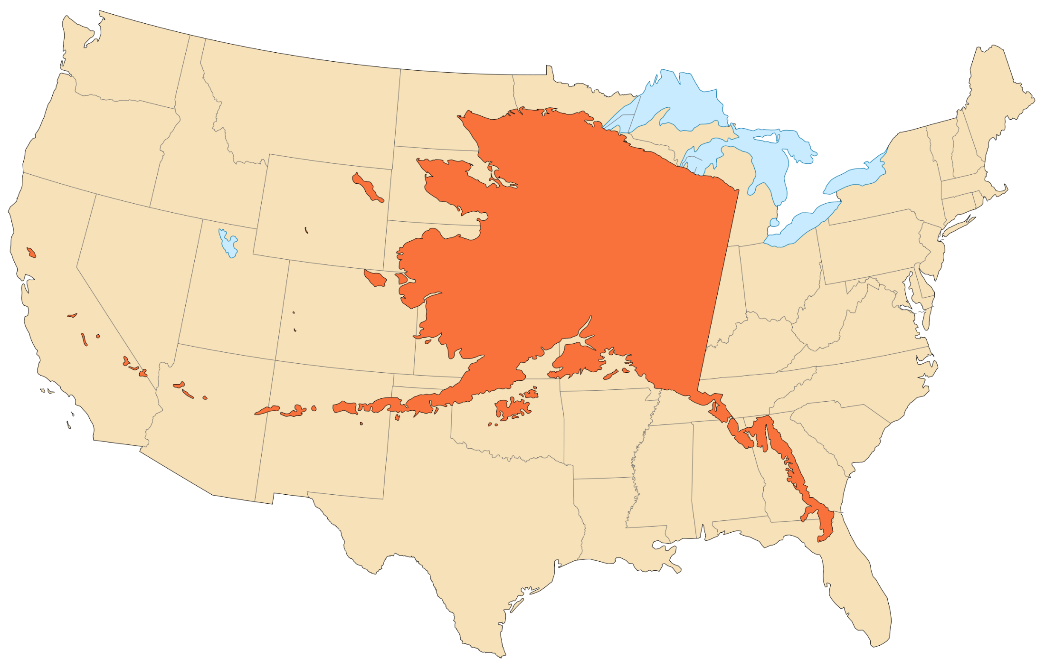

Slide 11
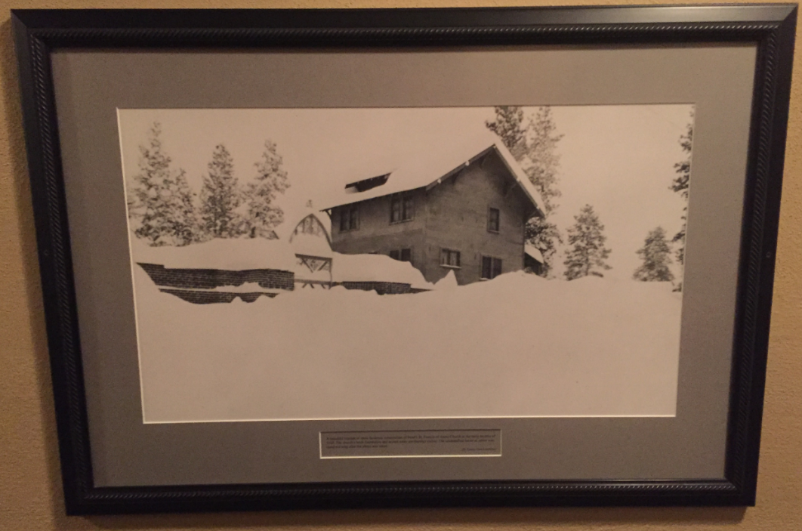
“A beautiful blanket of snow hindered construction of Bend’s
St. Francis of Assisi Church in the early months of 1920. The
church’s brick foundation and arched entry are (barely) visible.”

Slide 12
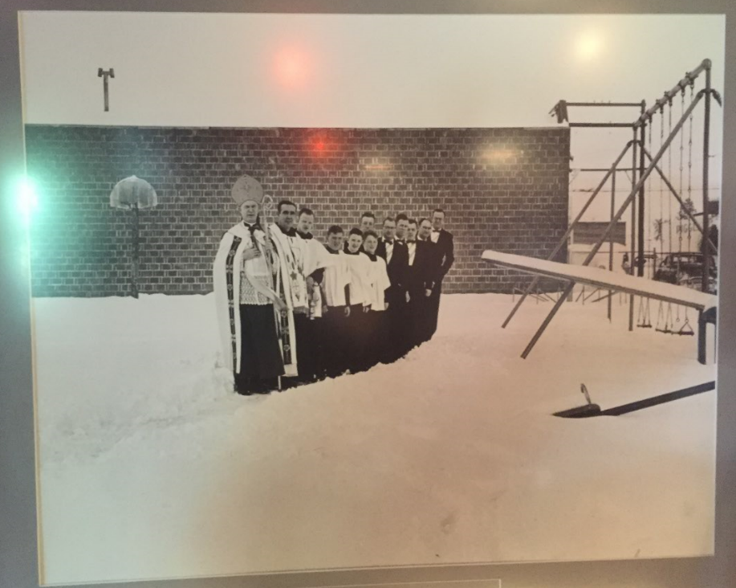

Slide 13
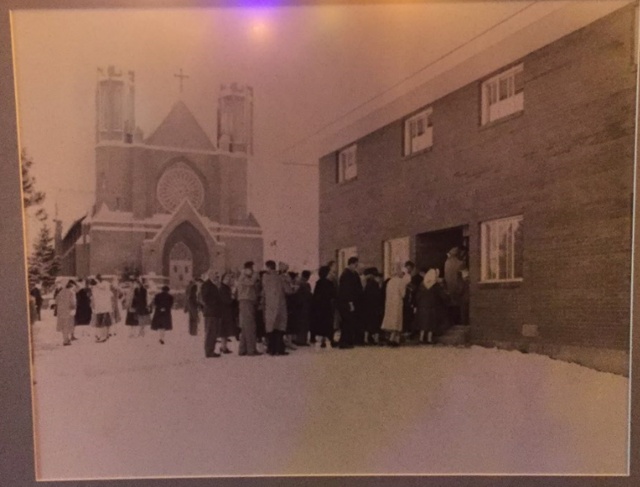

Slide 14
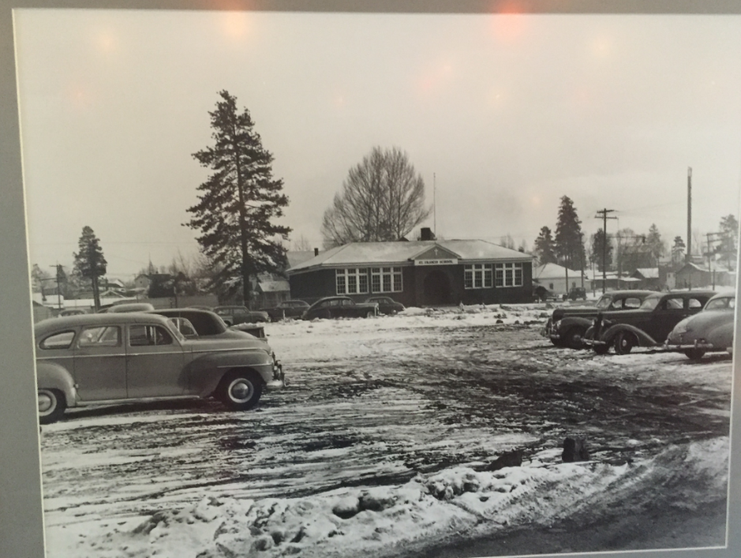

Slide 15
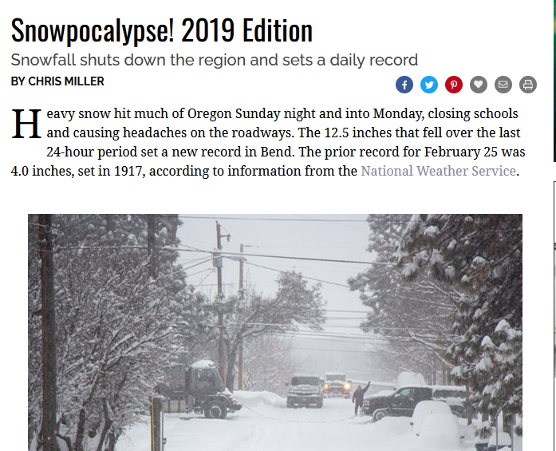
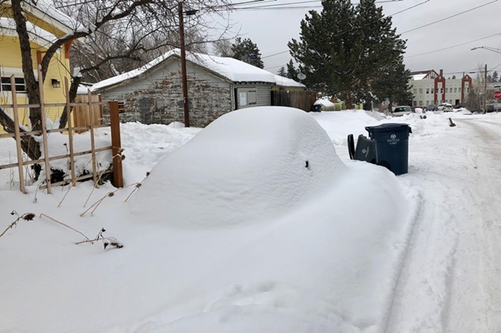

Slide 16
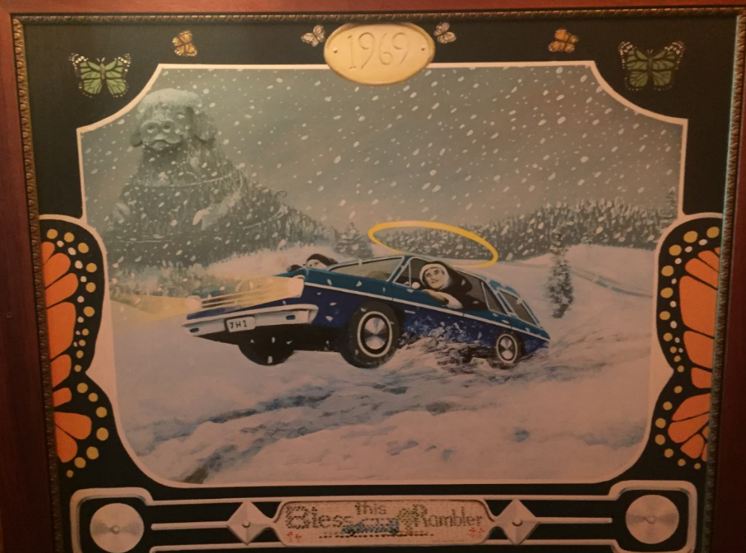
Let’s take a look, shall we?

