Slide 1
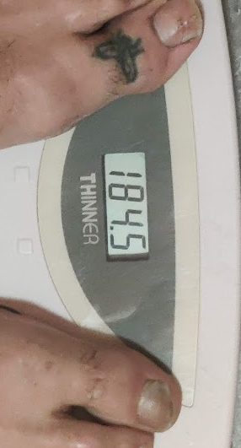
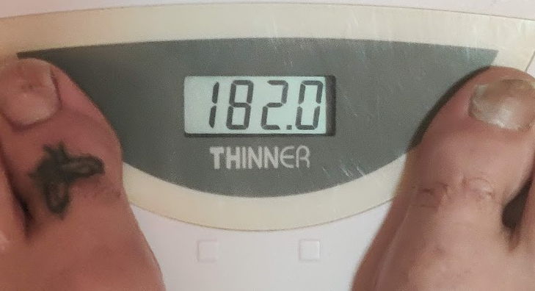
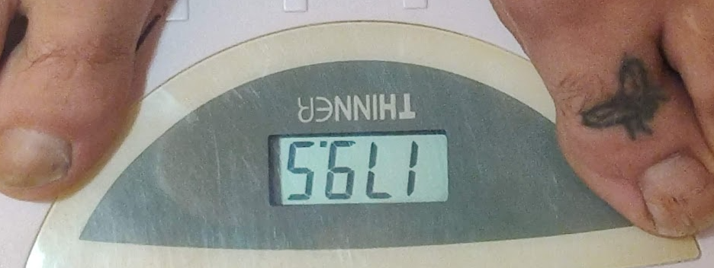
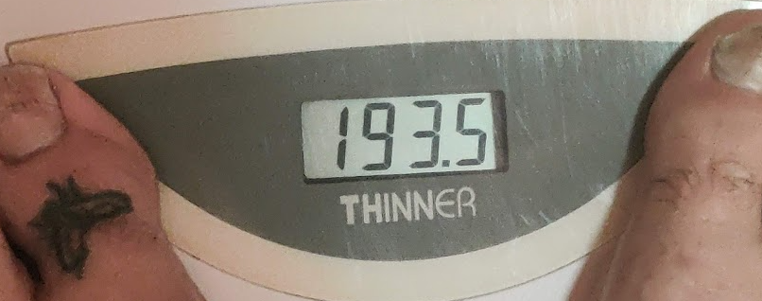
Outliers, baby!
Roll 6 dice?
How much do I weigh (nearest 5 pounds)?
Bend house sale prices!

Slide 2
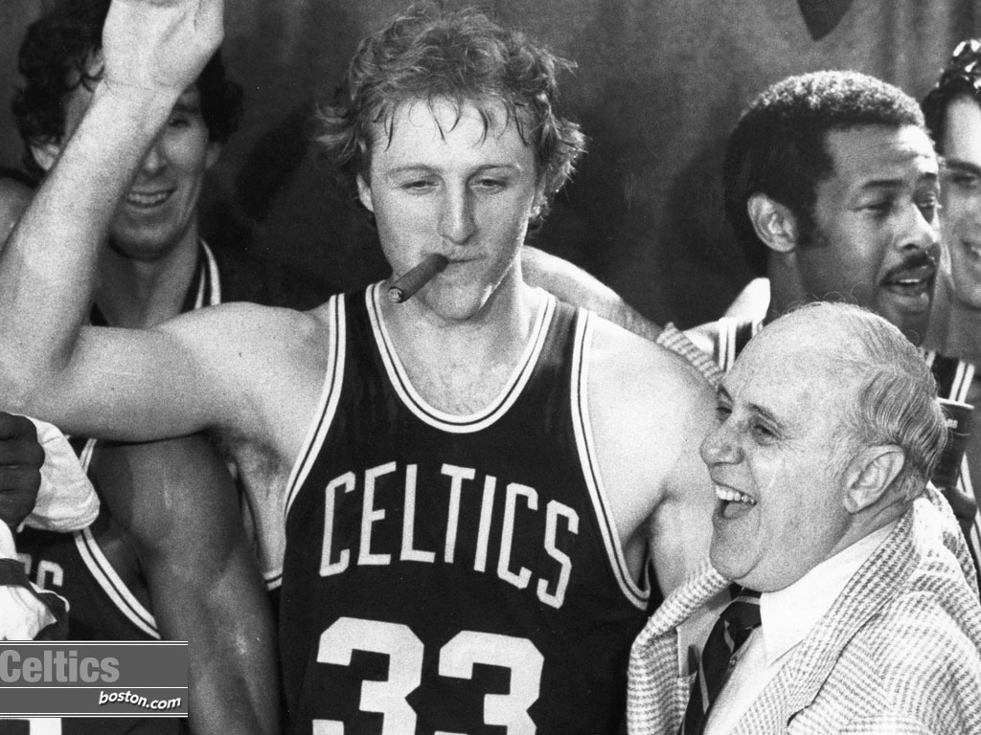
Why do we care about outliers?
Should we use the average?

Slide 3
Why do we care about outliers?
Should we use the average?
We can find potentially erroneous data.
Let’s take a peek!

Slide 4
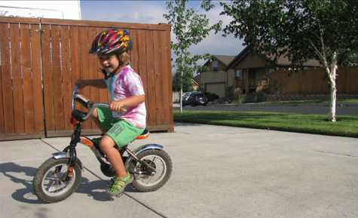
Why do we care about outliers?
Should we use the average?
We can find potentially erroneous data.
Their presence might show a meaningful
(albeit unexpected) nuance:

