Slide 1
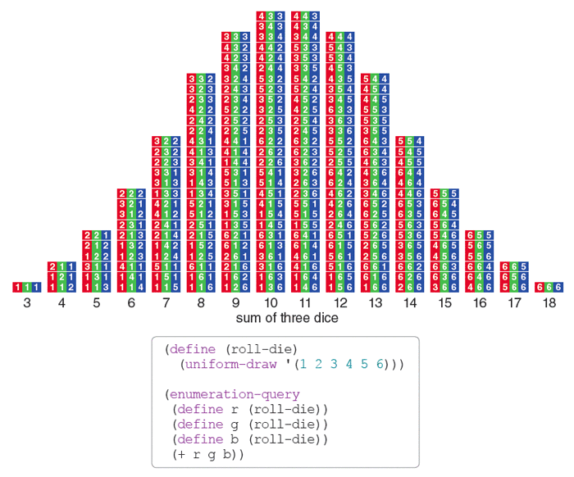

Slide 2
Features of a Probability Distribution!
All (mutually exclusive) possible outcomes of the experiment are listed in the X column!
2) All corresponding probabilities of each outcomes are listed in the P(X) column!
3) Because of 1 and 2, what must Σ P(X) be?

Slide 3
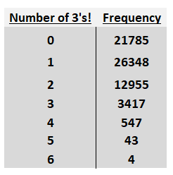
Frequency Distribution!

Slide 4
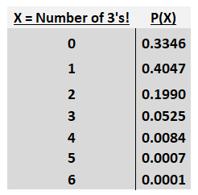
Probability Distribution!
Tell me everything you can about it!
Shape of the distribution!
Mean!
Median!
Mode!
Quartiles!
Standard deviation!
Everything!

Slide 5
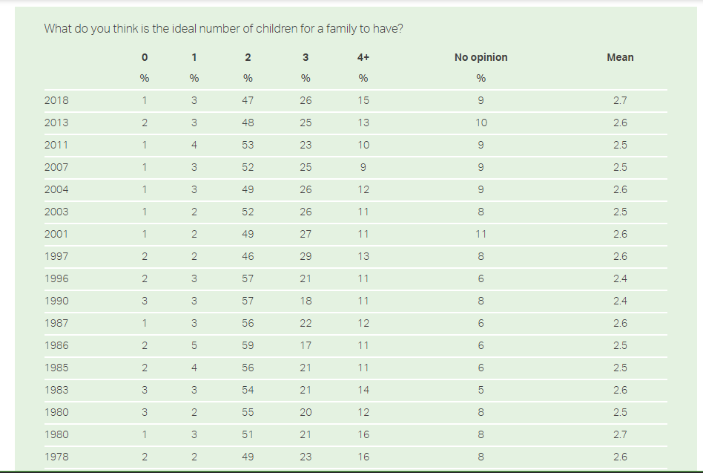
https://news.gallup.com/poll/1588/children-violence.aspx

