Slide 1
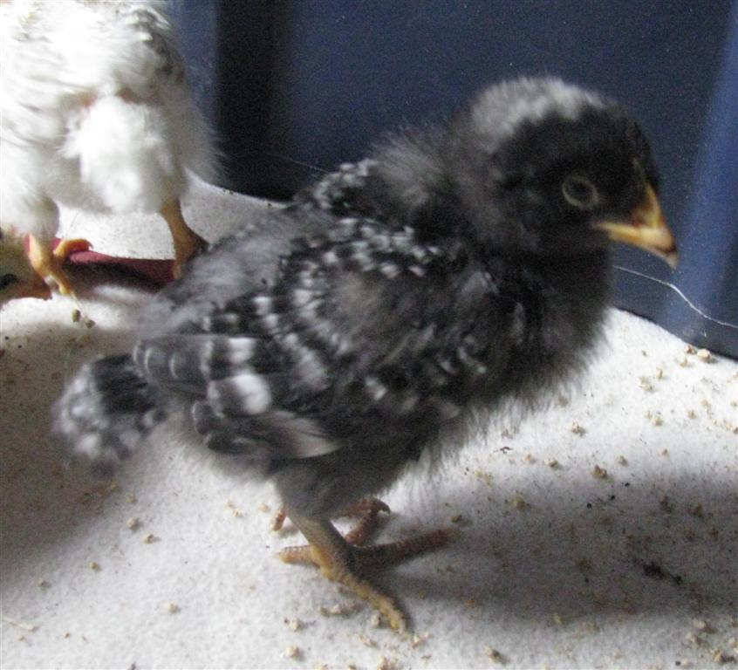
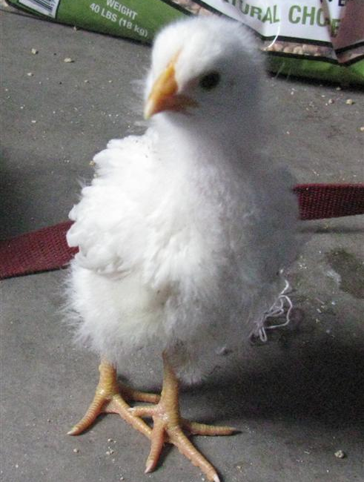
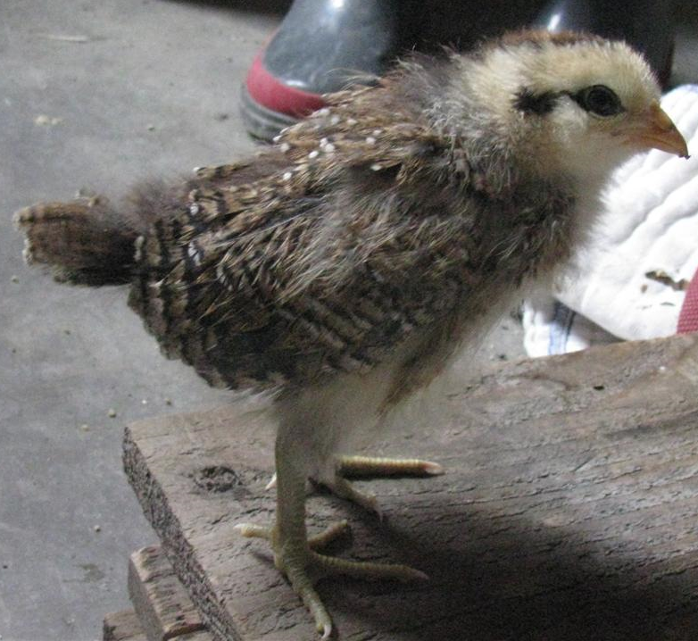
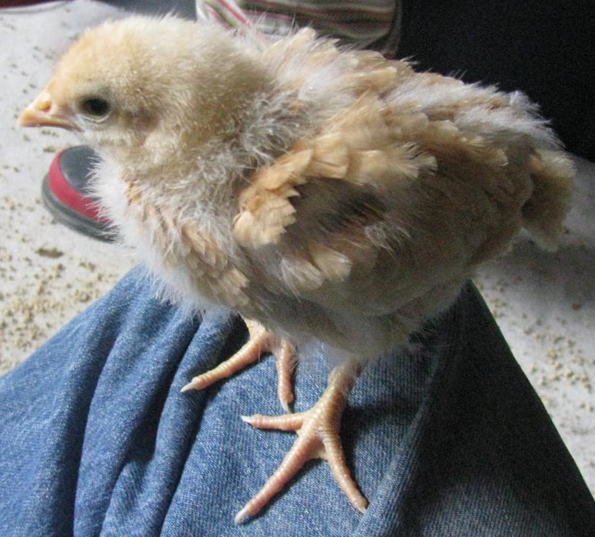

Slide 2
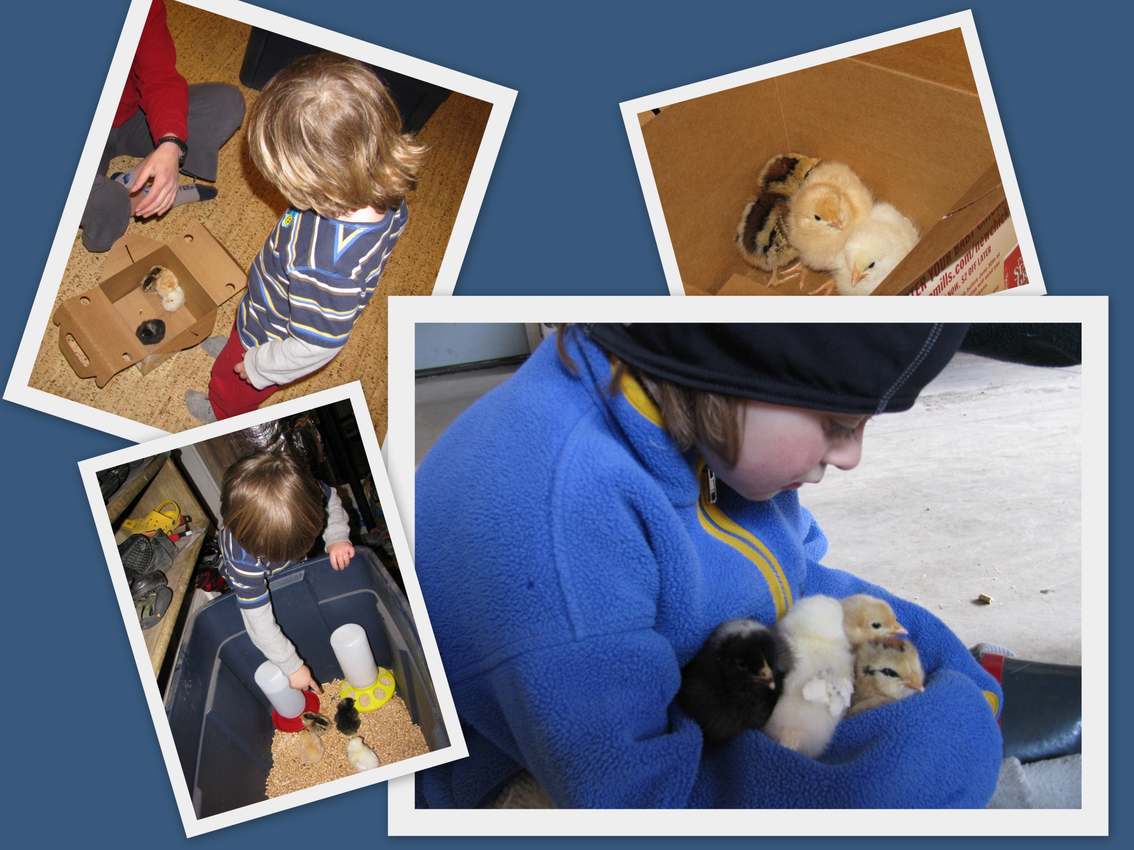

Slide 3
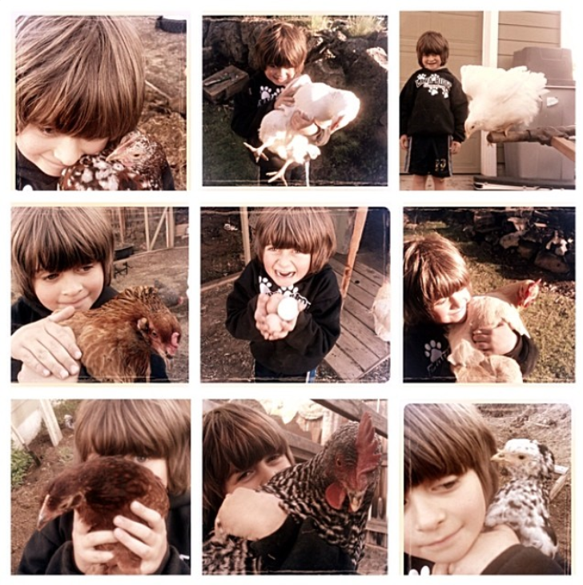

Slide 4
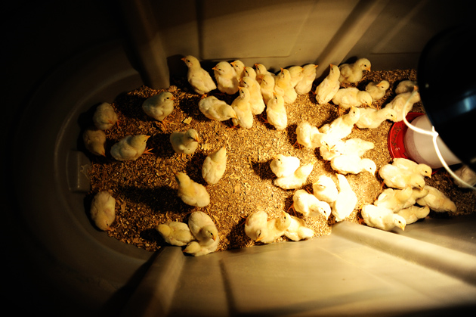
P(“female” chick is actually female) = 0.9
We selected 4 chicks (from ~1000 in the store)

Slide 9
Binomial Random Variables
Binomial experiments have…
1) …a fixed number of independent trials…
For this exercise, it’s the 4 chicks!
(can you think of a reason they might not be independent?)
2) …with two mutually exclusive outcomes per trial…
3) …with a constant probability of occurrence per trial.

Slide 10
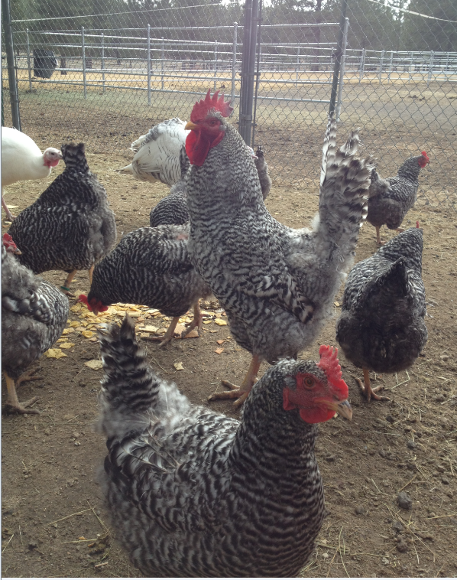

Slide 11
Does this describe a binomial experiment?
Rolling a single die, and
counting the pips you get.
Roll a single die.
If you roll 3, you win $4.
If not, you lose $1.

Slide 12
Does this describe a binomial experiment?
Rolling two dice, and
summing the pips you get.
Rolling two dice….you win
if you get a sum of7 or 11.
Rolling two dice 5 times, and
betting on 7 or 11 each time.

Slide 13
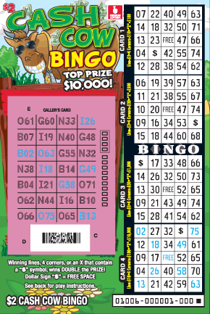
Does this describe a binomial experiment?
Buying 4 Oregon Cash Cow Bingo Scratchoffs for 2$ each and keeping track of how many win.
(overall chance of winning per ticket: 1 in 3.54)

Slide 14
Does this describe a binomial experiment?
About 7% of American men have
red/green color blindness (RGCB).
You select 20 at random and check
to see how many have RGCB.

Slide 15
Does this describe a binomial experiment?
About 7% of American men have
red/green color blindness (RGCB).
You keep selecting men at random
until you’ve found 20 that have RGCB.

Slide 16
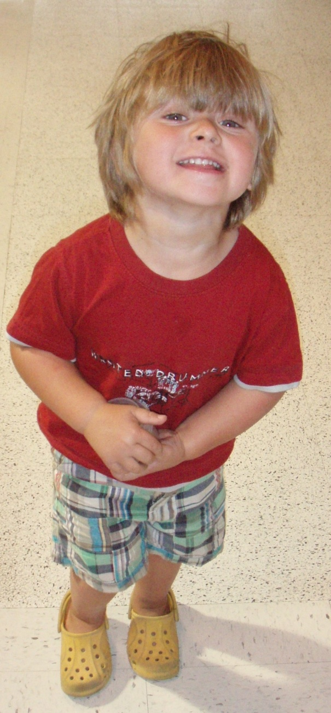
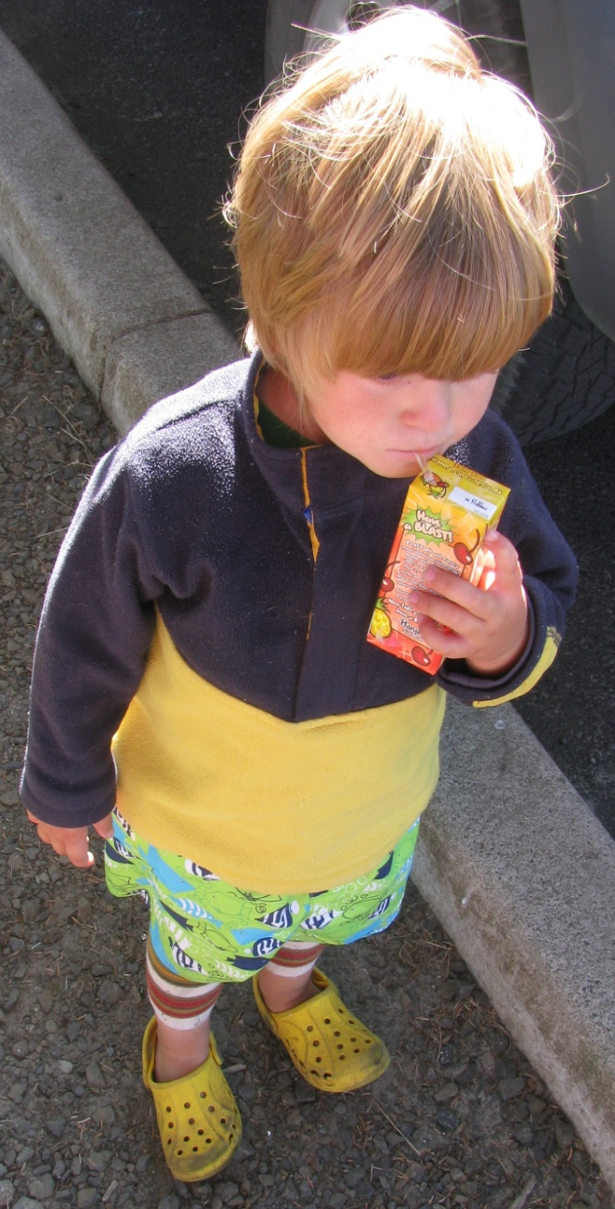
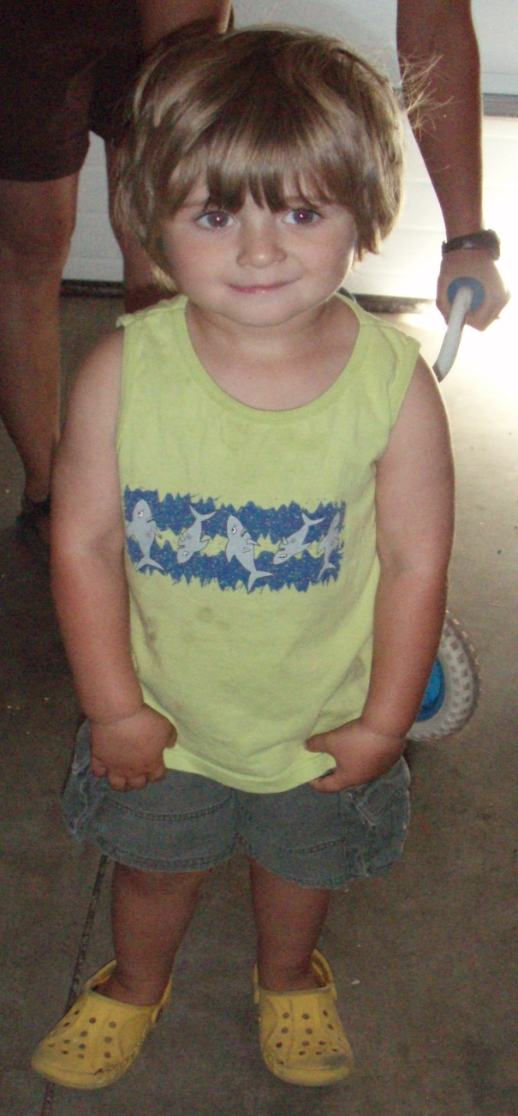
…Max, summer 2010…

Slide 17
Assume Max is guessing when he puts his Crocs
on, and assume he tries 10 times...is
that a binomial experiment?
Let’s continue this with an in-class quiz!

