Slide 1
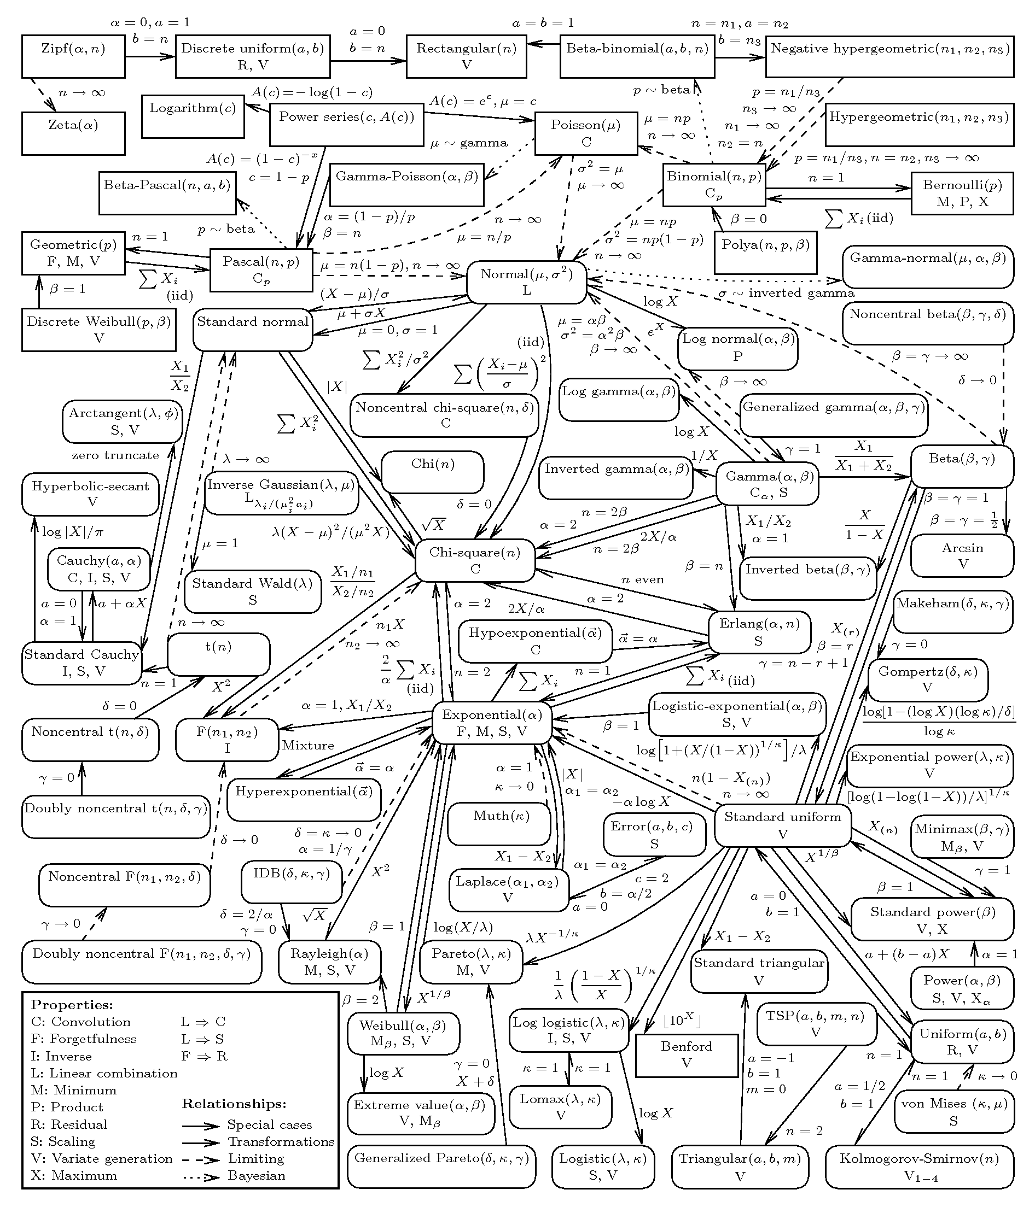

Slide 3
Assume a binomial distribution has p = ½.
Let’s look at some of its probability
distributions for a variety of numbers of trials...

Slide 4
n = 3

Slide 5
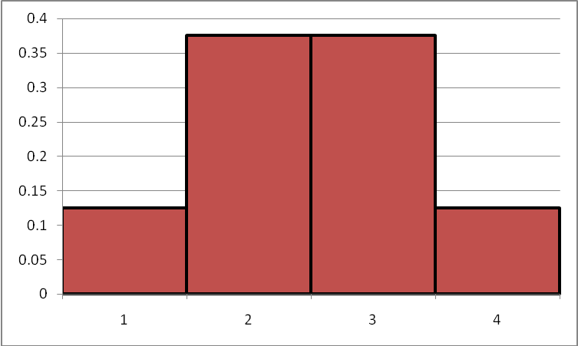
n = 5

Slide 6
n = 10

Slide 7
n = 25

Slide 8
n = 50

Slide 9
n = 100
Yeah, OK – but what if p ISN’T 50%?

Slide 11
n = 4
n = 7

Slide 12
n = 20

Slide 13
n = 50
n = 100

Slide 14
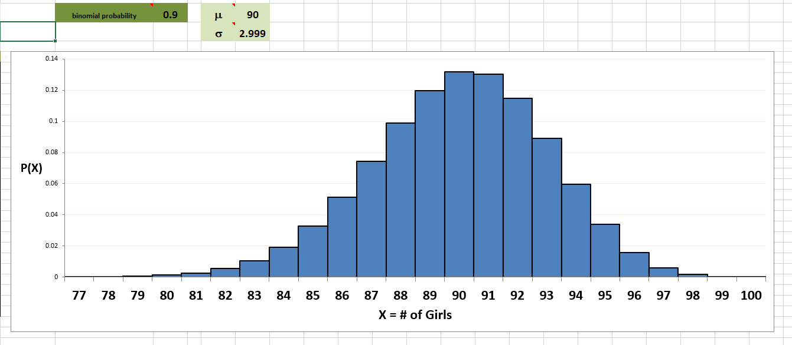
n = 100
(another look)

Slide 15
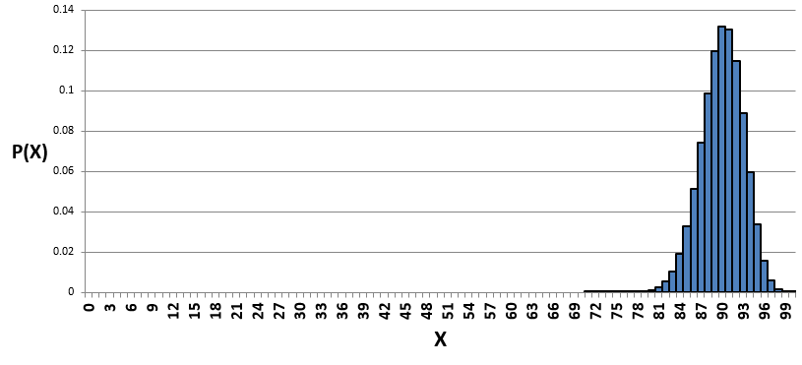
Remember that the last binomial distribution actually looks like this:
Why’s it OK (mathematically and statistically) to ignore every possibility from about 0 to 77 hens?

Slide 16
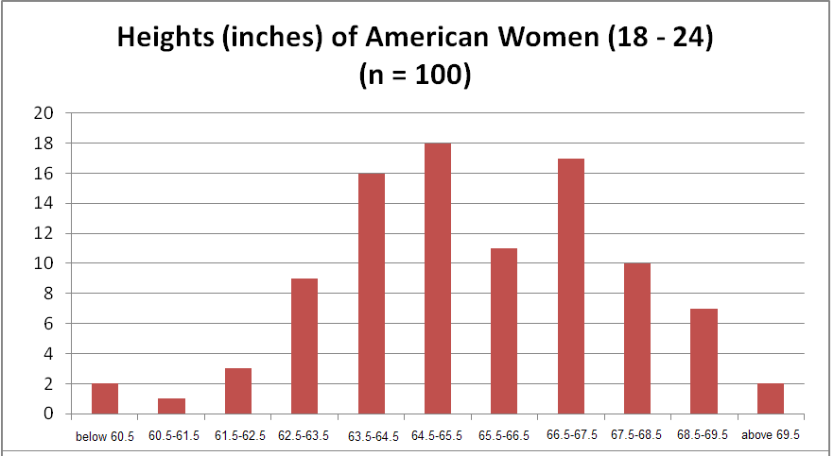
Some of the many, many things that are bell-shaped (normally distributed)!

Slide 17
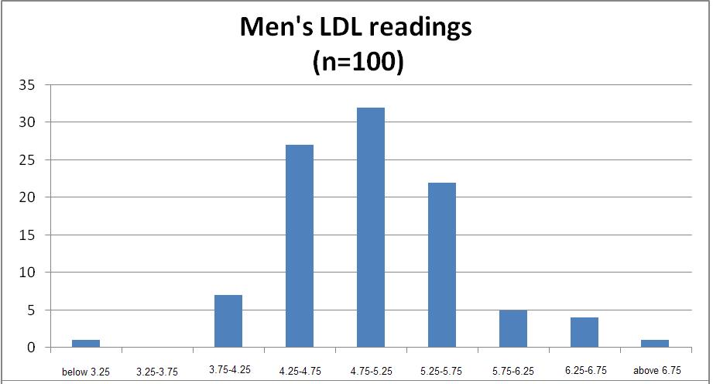

Slide 18
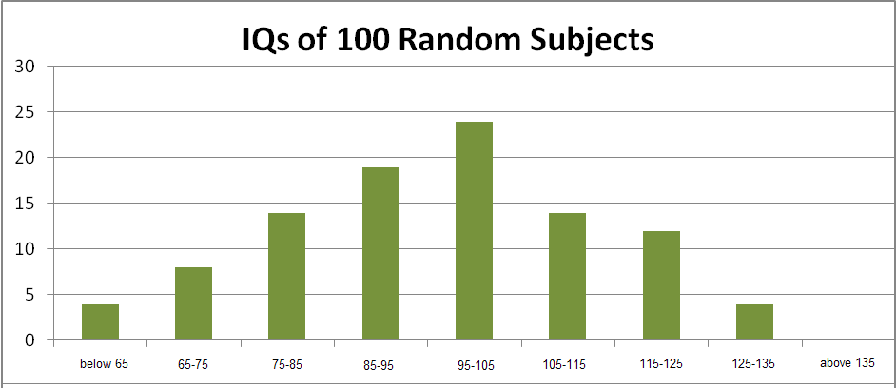

Slide 21
“Hang on, Sean! There’s a BIG difference between “Max checking out balls dropping in OMSI” (which are discrete things) and stuff like “height and weight” (which are continuous)! What gives?”
“I know what you’re thinking…”

Slide 22
Some Means and Standard Deviations of some Normally Distributed (“bell – shaped”) Data Sets!
 | μ | σ
American Newborn Weight | 7.5 pounds | 1.3 pounds
A former student weighed 2.3 pounds at birth. How many standard deviations below average was she?
I weighed about 10 pounds at birth…how many STDEVs above average was I, and what was my approximate percentile rank?

Slide 23
Some Means and Standard Deviations of some Normally Distributed (“bell – shaped”) Data Sets!
 | μ | σ
American Newborn Weight | 7.5 pounds | 1.3 pounds
Hardwood Tree Heartwood Diameter | 4 cm | 1.8 cm
Average Life Expectancy American Male (sample of size n=100) | 76 years | 1.5 years
Life Expectancy American Female (sample of size n=100) | 78 years | 1.5 years
IQ scores | 100 (somethings) | 15 (somethings)
Pregnancy length | 266 days | 16 days

Slide 24
The length of human pregnancies from conception to birth varies (roughly) according to a distribution that is approximately normal with a mean of 266 days and a standard deviation of 16 days.
What is the cutoff for the shortest 5% of all pregnancies? This is P₅, and births shorter than these are called premature births.
Labor is usually induced if an expectant mother has exceeded her due date by 2 weeks. Find the probability that a pregnancy will last more than 2 weeks past the due date.

