Slide 1
 | The deck is fair. | The deck is not fair.
Say, “the deck isn’t fair.” | Oops. (false positive) | Right!
Say, “the deck is fair” | Right! | Oops. (false negative)
One of these will be true about your
population…but you don’t
know which one.

Slide 2
 | The deck is fair. | The deck is not fair.
Say, “the deck isn’t fair.” | Oops. (false positive) | Right!
Say, “the deck is fair” | Right! | Oops. (false negative)
You’ll make one of these claims,
based on your sample

Slide 3
 | The deck is fair. | The deck is not fair.
Say, “the deck isn’t fair.” | Oops. (false positive) | Right!
Say, “the deck is fair” | Right! | Oops. (false negative)

Slide 4
 | The deck is fair. | The deck is not fair.
Say, “the deck isn’t fair.” | Oops. (false positive) | Right!
Say, “the deck is fair” | Right! | Oops. (false negative)

Slide 5
 | The deck is fair. | The deck is not fair.
Say, “the deck isn’t fair.” | Oops. (false positive) | Right!
Say, “the deck is fair” | Right! | Oops. (false negative)

Slide 6
 | The deck is fair. | The deck is not fair.
Say, “the deck isn’t fair.” | Oops. (false positive) | Right!
Say, “the deck is fair” | Right! | Oops. (false negative)
Why are we even HERE?

Slide 7
Unbiased Estimators are statistics which accurately target the parameters they aim to target (catch them “on average”).

Slide 8
In the interest of time…
(10 weeks < time we need to do more, well)

Slide 9
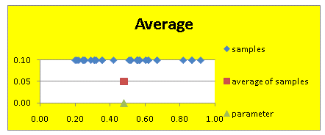
Each individual statistic will most likely be “off” a bit in value from the parameter (“sampling error”)…for example…

Slide 10
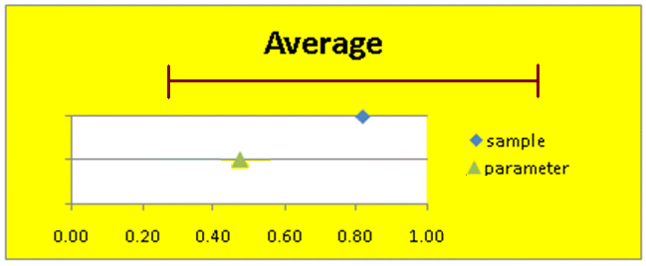
…so, in MTH 244, we will learn to build a “margin of error” (MOE) around our statistics to mitigate as much error as possible…

Slide 11
To properly estimate a parameter from a sample,
you need to form a confidence interval (CI)…
1. Start with a random sample…
2. Find the center of interest of your sample…in MTH 244, that’ll be either a percentage or an average.
3. Give the center its MOE to help alleviate any sampling error.

Slide 12
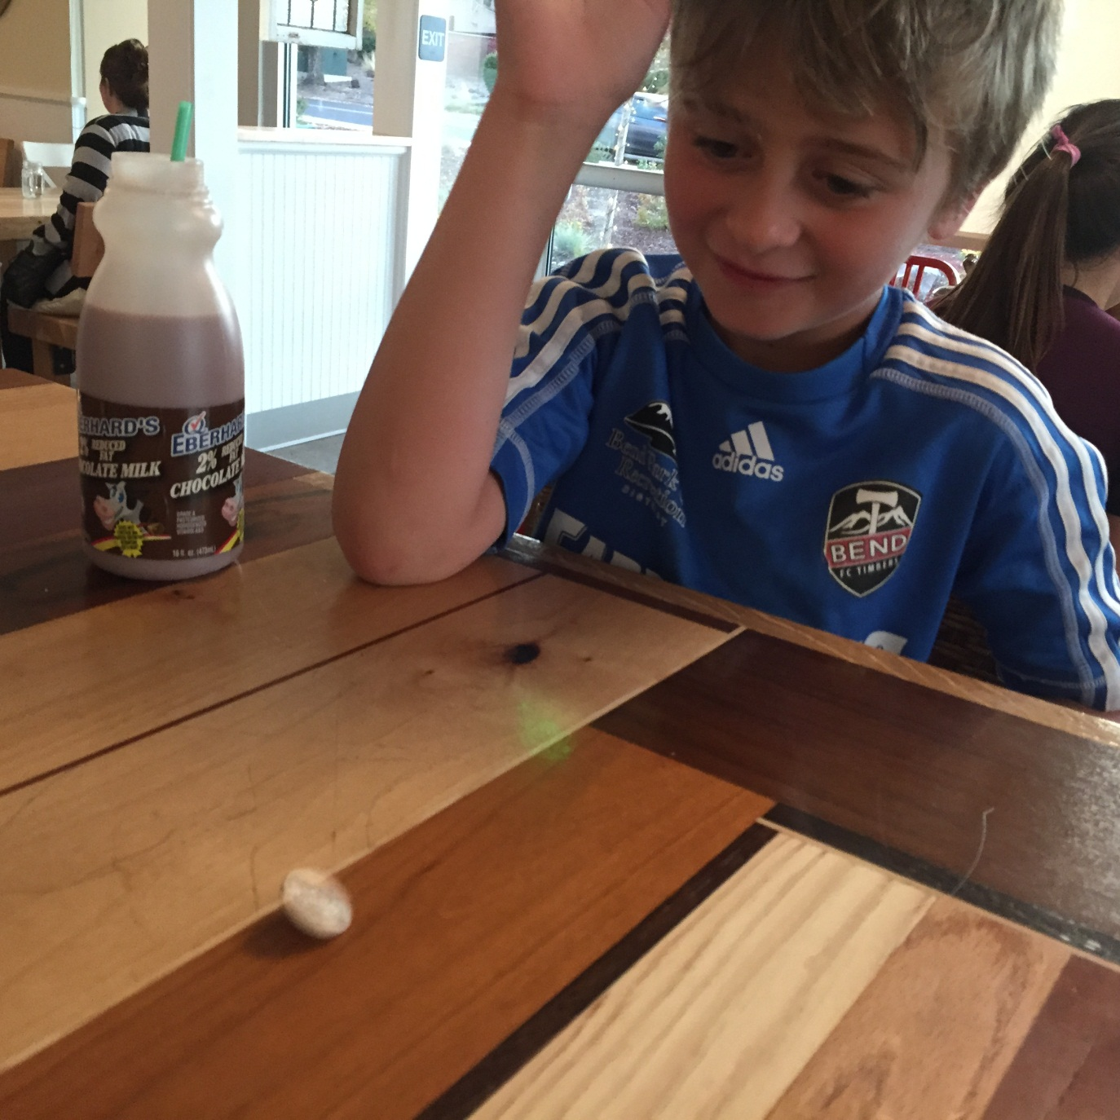
Let’s play!
Let’s do an in - class quiz!

Slide 13
FAQ about Confidence!
What is “Confidence?”
Why not just use 100% confidence?
What’s a “Margin of Error”, again?
Why do we need it?
Is MOE like standard deviation?

Slide 14
Let’s play!
Let’s do an in - class quiz!

Slide 15
Quick Questions!
Suppose a sample has an average of 3 pounds.
Give the 95% confidence interval, assuming that
the MOE is 0.5 pound.
3 pounds ± 0.5 pound
(2.5 pounds, 3.5 pounds)
Both a and b!

Slide 16
Quick Questions!
What do you think will happen to the MOE
as your sample size increases?
Nothing
It will get smaller
It will get bigger
Now…why?

Slide 17
Quick Questions!
What do you think will happen to the MOE
as your confidence increases?
Nothing
It will get smaller
It will get bigger
Now…why?
This might help!

Slide 18
August 19, 2016 Gallup Daily: Less Than Half of Republicans Pleased With Trump as Nominee Less than half of Republicans, 46%, are pleased that Donald Trump is their party's presidential nominee, while a slight majority, 52%, wish their party had nominated someone else. Results for this Gallup poll are based on telephone interviews conducted Aug. 15-16, 2016, on the Gallup U.S. Daily survey, with a random sample of 1,013 adults, aged 18 and older, living in all 50 U.S. states and the District of Columbia. For results based on the total sample of 466 Republicans and Republican-leaning independents, the margin of sampling error is ±6 percentage points at the 95% confidence level.

Slide 19
August 19, 2016 Gallup Daily: Less Than Half of Republicans Pleased With Trump as Nominee Less than half of Republicans, 46%, are pleased that Donald Trump is their party's presidential nominee, while a slight majority, 52%, wish their party had nominated someone else. Results for this Gallup poll are based on telephone interviews conducted Aug. 15-16, 2016, on the Gallup U.S. Daily survey, with a random sample of 1,013 adults, aged 18 and older, living in all 50 U.S. states and the District of Columbia. For results based on the total sample of 466 Republicans and Republican-leaning independents, the margin of sampling error is ±6 percentage points at the 95% confidence level.

Slide 20
August 19, 2016 Gallup Daily: Less Than Half of Republicans Pleased With Trump as Nominee Less than half of Republicans, 46%, are pleased that Donald Trump is their party's presidential nominee, while a slight majority, 52%, wish their party had nominated someone else. Results for this Gallup poll are based on telephone interviews conducted Aug. 15-16, 2016, on the Gallup U.S. Daily survey, with a random sample of 1,013 adults, aged 18 and older, living in all 50 U.S. states and the District of Columbia. For results based on the total sample of 466 Republicans and Republican-leaning independents, the margin of sampling error is ±6 percentage points at the 95% confidence level.

Slide 21
August 19, 2016 Gallup Daily: Less Than Half of Republicans Pleased With Trump as Nominee Less than half of Republicans, 46%, are pleased that Donald Trump is their party's presidential nominee, while a slight majority, 52%, wish their party had nominated someone else. Results for this Gallup poll are based on telephone interviews conducted Aug. 15-16, 2016, on the Gallup U.S. Daily survey, with a random sample of 1,013 adults, aged 18 and older, living in all 50 U.S. states and the District of Columbia. For results based on the total sample of 466 Republicans and Republican-leaning independents, the margin of sampling error is ±6 percentage points at the 95% confidence level.

Slide 22
August 19, 2016 Gallup Daily: Less Than Half of Republicans Pleased With Trump as Nominee Less than half of Republicans, 46%, are pleased that Donald Trump is their party's presidential nominee, while a slight majority, 52%, wish their party had nominated someone else. Results for this Gallup poll are based on telephone interviews conducted Aug. 15-16, 2016, on the Gallup U.S. Daily survey, with a random sample of 1,013 adults, aged 18 and older, living in all 50 U.S. states and the District of Columbia. For results based on the total sample of 466 Republicans and Republican-leaning independents, the margin of sampling error is ±6 percentage points at the 95% confidence level.

Slide 23
August 19, 2016 Gallup Daily: Less Than Half of Republicans Pleased With Trump as Nominee Less than half of Republicans, 46%, are pleased that Donald Trump is their party's presidential nominee, while a slight majority, 52%, wish their party had nominated someone else. Results for this Gallup poll are based on telephone interviews conducted Aug. 15-16, 2016, on the Gallup U.S. Daily survey, with a random sample of 1,013 adults, aged 18 and older, living in all 50 U.S. states and the District of Columbia. For results based on the total sample of 466 Republicans and Republican-leaning independents, the margin of sampling error is ±6 percentage points at the 95% confidence level.

Slide 24
August 19, 2016 Gallup Daily: Less Than Half of Republicans Pleased With Trump as Nominee Less than half of Republicans, 46%, are pleased that Donald Trump is their party's presidential nominee, while a slight majority, 52%, wish their party had nominated someone else. Results for this Gallup poll are based on telephone interviews conducted Aug. 15-16, 2016, on the Gallup U.S. Daily survey, with a random sample of 1,013 adults, aged 18 and older, living in all 50 U.S. states and the District of Columbia. For results based on the total sample of 466 Republicans and Republican-leaning independents, the margin of sampling error is ±6 percentage points at the 95% confidence level.

Slide 25
August 19, 2016 Gallup Daily: Less Than Half of Republicans Pleased With Trump as Nominee Less than half of Republicans, 46%, are pleased that Donald Trump is their party's presidential nominee, while a slight majority, 52%, wish their party had nominated someone else. Results for this Gallup poll are based on telephone interviews conducted Aug. 15-16, 2016, on the Gallup U.S. Daily survey, with a random sample of 1,013 adults, aged 18 and older, living in all 50 U.S. states and the District of Columbia. For results based on the total sample of 466 Republicans and Republican-leaning independents, the margin of sampling error is ±6 percentage points at the 95% confidence level.

Slide 26
August 19, 2016 Gallup Daily: Less Than Half of Republicans Pleased With Trump as Nominee Less than half of Republicans, 46%, are pleased that Donald Trump is their party's presidential nominee, while a slight majority, 52%, wish their party had nominated someone else. Results for this Gallup poll are based on telephone interviews conducted Aug. 15-16, 2016, on the Gallup U.S. Daily survey, with a random sample of 1,013 adults, aged 18 and older, living in all 50 U.S. states and the District of Columbia. For results based on the total sample of 466 Republicans and Republican-leaning independents, the margin of sampling error is ±6 percentage points at the 95% confidence level.

Slide 27
August 19, 2016 Gallup Daily: Less Than Half of Republicans Pleased With Trump as Nominee Less than half of Republicans, 46%, are pleased that Donald Trump is their party's presidential nominee, while a slight majority, 52%, wish their party had nominated someone else. Results for this Gallup poll are based on telephone interviews conducted Aug. 15-16, 2016, on the Gallup U.S. Daily survey, with a random sample of 1,013 adults, aged 18 and older, living in all 50 U.S. states and the District of Columbia. For results based on the total sample of 466 Republicans and Republican-leaning independents, the margin of sampling error is ±6 percentage points at the 95% confidence level.

Slide 28
August 19, 2016 Gallup Daily: Less Than Half of Republicans Pleased With Trump as Nominee Less than half of Republicans, 46%, are pleased that Donald Trump is their party's presidential nominee, while a slight majority, 52%, wish their party had nominated someone else. Results for this Gallup poll are based on telephone interviews conducted Aug. 15-16, 2016, on the Gallup U.S. Daily survey, with a random sample of 1,013 adults, aged 18 and older, living in all 50 U.S. states and the District of Columbia. For results based on the total sample of 466 Republicans and Republican-leaning independents, the margin of sampling error is ±6 percentage points at the 95% confidence level.

Slide 29
August 19, 2016 Gallup Daily: Less Than Half of Republicans Pleased With Trump as Nominee Less than half of Republicans, 46%, are pleased that Donald Trump is their party's presidential nominee, while a slight majority, 52%, wish their party had nominated someone else. Results for this Gallup poll are based on telephone interviews conducted Aug. 15-16, 2016, on the Gallup U.S. Daily survey, with a random sample of 1,013 adults, aged 18 and older, living in all 50 U.S. states and the District of Columbia. For results based on the total sample of 466 Republicans and Republican-leaning independents, the margin of sampling error is ±6 percentage points at the 95% confidence level.

Slide 30
August 19, 2016 Gallup Daily: Less Than Half of Republicans Pleased With Trump as Nominee Less than half of Republicans, 46%, are pleased that Donald Trump is their party's presidential nominee, while a slight majority, 52%, wish their party had nominated someone else. Results for this Gallup poll are based on telephone interviews conducted Aug. 15-16, 2016, on the Gallup U.S. Daily survey, with a random sample of 1,013 adults, aged 18 and older, living in all 50 U.S. states and the District of Columbia. For results based on the total sample of 466 Republicans and Republican-leaning independents, the margin of sampling error is ±6 percentage points at the 95% confidence level.

Slide 31
August 19, 2016 Gallup Daily: Less Than Half of Republicans Pleased With Trump as Nominee Less than half of Republicans, 46%, are pleased that Donald Trump is their party's presidential nominee, while a slight majority, 52%, wish their party had nominated someone else. Results for this Gallup poll are based on telephone interviews conducted Aug. 15-16, 2016, on the Gallup U.S. Daily survey, with a random sample of 1,013 adults, aged 18 and older, living in all 50 U.S. states and the District of Columbia. For results based on the total sample of 466 Republicans and Republican-leaning independents, the margin of sampling error is ±6 percentage points at the 95% confidence level.

Slide 32
August 19, 2016 Gallup Daily: Less Than Half of Republicans Pleased With Trump as Nominee Less than half of Republicans, 46%, are pleased that Donald Trump is their party's presidential nominee, while a slight majority, 52%, wish their party had nominated someone else. Results for this Gallup poll are based on telephone interviews conducted Aug. 15-16, 2016, on the Gallup U.S. Daily survey, with a random sample of 1,013 adults, aged 18 and older, living in all 50 U.S. states and the District of Columbia. For results based on the total sample of 466 Republicans and Republican-leaning independents, the margin of sampling error is ±6 percentage points at the 95% confidence level.

Slide 33
August 19, 2016 Gallup Daily: Less Than Half of Republicans Pleased With Trump as Nominee Less than half of Republicans, 46%, are pleased that Donald Trump is their party's presidential nominee, while a slight majority, 52%, wish their party had nominated someone else. Results for this Gallup poll are based on telephone interviews conducted Aug. 15-16, 2016, on the Gallup U.S. Daily survey, with a random sample of 1,013 adults, aged 18 and older, living in all 50 U.S. states and the District of Columbia. For results based on the total sample of 466 Republicans and Republican-leaning independents, the margin of sampling error is ±6 percentage points at the 95% confidence level.

Slide 34
August 19, 2016 Gallup Daily: Less Than Half of Republicans Pleased With Trump as Nominee Less than half of Republicans, 46%, are pleased that Donald Trump is their party's presidential nominee, while a slight majority, 52%, wish their party had nominated someone else. Results for this Gallup poll are based on telephone interviews conducted Aug. 15-16, 2016, on the Gallup U.S. Daily survey, with a random sample of 1,013 adults, aged 18 and older, living in all 50 U.S. states and the District of Columbia. For results based on the total sample of 466 Republicans and Republican-leaning independents, the margin of sampling error is ±6 percentage points at the 95% confidence level.

Slide 35
January 15, 2014 Rasmussen Reports: Right Direction or Wrong Track For the second week in a row, 29% of Likely U.S. Voters think the country is heading in the right direction, according to a new Rasmussen Reports national telephone survey for the week ending January 12. In early October during the federal government shutdown, confidence in the country’s course fell to 13%, the lowest finding in five years. A year ago, 36% said the country was heading in the right direction. The national telephone survey of 3,500 likely voters was conducted by Rasmussen Reports on January 6-12, 2014. The margin of sampling error for the survey is +/- 2 percentage points with a 95% level of confidence.

Slide 36
January 15, 2014 Rasmussen Reports: Right Direction or Wrong Track For the second week in a row, 29% of Likely U.S. Voters think the country is heading in the right direction, according to a new Rasmussen Reports national telephone survey for the week ending January 12. In early October during the federal government shutdown, confidence in the country’s course fell to 13%, the lowest finding in five years. A year ago, 36% said the country was heading in the right direction. The national telephone survey of 3,500 likely voters was conducted by Rasmussen Reports on January 6-12, 2014. The margin of sampling error for the survey is +/- 2 percentage points with a 95% level of confidence.
But what’s a small problem here?

