Slide 1
What’s the chance of spinning
heads on a penny?

Slide 2
The Wonderful Bernoulli Distribution!
(fixed number of trials n, constant probability of success p)
Population Average (%) | Population Standard Deviation (%)
μ = p
$$σ=\sqrt{pq}$$
Sampling Based on the W.B.D.!
(population believed to have constant, but unknown, probability of success p)
Sample Average (%) | Standard Error (%) | Margin of Error (%)
$$SE=\sqrt{\frac{\hat{p}\hat{q}}{n}}$$
$$ME=zcritical\sqrt{\frac{\hat{p}\hat{q}}{n}}$$
$$\hat{p}= \frac{x}{n}$$

Slide 3
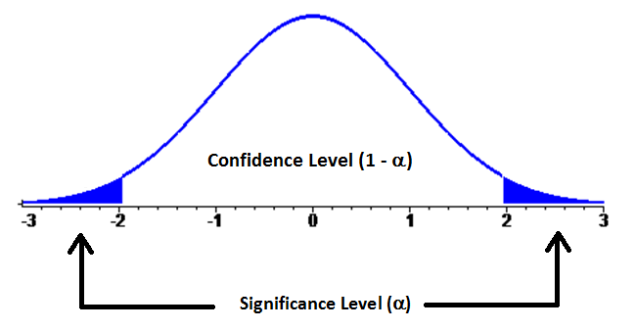
Confidence (area) | “critical” z values
68% | 1
90% | 1.645
95% | 2 (actually, 1.96)
99% | 2.575
99.7% | 3
But, um…why “z”?

Slide 4
You might recall (from MTH 243) that binomial distributions’ histograms begin to look like bell curves if 1) p ≈ 0.5 and 2) n is very large.

Slide 5
You might recall (from MTH 243) that binomial distributions’ histograms begin to look like bell curves if 1) p ≈ 0.5 and 2) n is very large.

Slide 6
You might recall (from MTH 243) that binomial distributions’ histograms begin to look like bell curves if 1) p ≈ 0.5 and 2) n is very large.

Slide 7
You might recall (from MTH 243) that binomial distributions’ histograms begin to look like bell curves if 1) p ≈ 0.5 and 2) n is very large.

Slide 8
You might recall (from MTH 243) that binomial distributions’ histograms begin to look like bell curves if 1) p ≈ 0.5 and 2) n is very large.

Slide 9
You might recall (from MTH 243) that binomial distributions’ histograms begin to look like bell curves if 1) p ≈ 0.5 and 2) n is very large.

Slide 10
So, for a given value of p (close to 0.5), as n → ∞, the distribution resembles a normal distribution more and more. But, what if p varies? In the next few slides, n = 20.

Slide 11
p = 0.5

Slide 12
p = 0.4

Slide 13
p = 0.3

Slide 14
p = 0.2

Slide 15
p = 0.1

Slide 16
So, as p begins to vary significantly from 0.5, the distributions skew more and more. But…watch what happens when n → ∞, even when p = 0.1 (highly skewed)...

Slide 17
n = 20
np = 20(0.1) = 2

Slide 18
n = 40
np = 40(0.1) = 4

Slide 19
n = 60
np = 60(0.1) = 6

Slide 20
n = 80
np = 80(0.1) = 8

Slide 21
n = 100
np = 100(0.1) = 10

Slide 22
So long as we can ensure that our sample is big enough (that is, np ≥ 5 and nq ≥ 5), our methods of proportional CI’s will be valid. It’s an even better fit when np ≥ 10 and nq ≥ 10.
(For a formal proof, check the enrichment page of the website)
“So – how big a sample do you need?”

