Slide 1
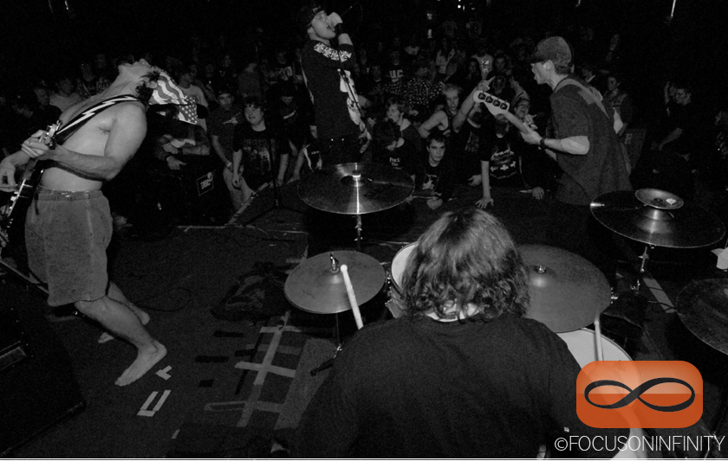

Slide 2
I randomly sampled thirty Del Taco ½ pound bean and cheese burritos (DTHPBCB):
0.542 | 0.541 | 0.563 | 0.518 | 0.509 | 0.558
0.489 | 0.547 | 0.549 | 0.586 | 0.542 | 0.563
0.515 | 0.495 | 0.512 | 0.524 | 0.490 | 0.498
0.524 | 0.537 | 0.498 | 0.550 | 0.496 | 0.521
0.509 | 0.539 | 0.525 | 0.534 | 0.514 | 0.493
(weights in pounds)
How much, on average, does a DTHPBCB weigh?

Slide 3
Estimation!
Proportion
(unknown p)
Average
(unknown μ)
“center”
“spread”

Slide 4
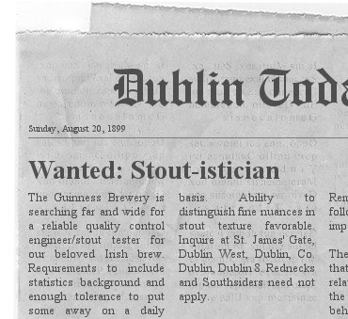
How

Slide 5
How
Helped shape MTH 244.

Slide 6
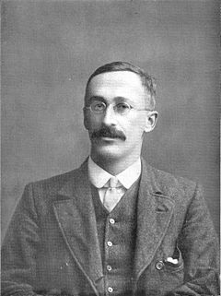
How
Employee: William Gossett
Date of Hire: 1899
Job Description: taste test enough random samples of world – famous Guinness Stout to ensure quality control
Obvious Challenge: staying sober while doing this to remain effective in post as quality controller
Proposed Solution: create a new distribution, like the normal, that allows for small sample sizes, so long as bell – shaped requirement is met, and accuracy maintained

Slide 7
How
Result: the Student’s – t distribution (usually just called the t distribution)
Constraints: unlike the normal, which relies on a μ and a σ, the t relies only on the number of “degrees of freedom”, defined to be n – 1.
Formula: well, if you must...
Gossett got this model by sampling using pieces of paper drawn out of a hat...hundreds of times!

Slide 8
How
Since the t depends only on sample size as a variable, the curve changes shape as the sample size changes.
Let’s take a look at the t – distribution, side – by – side with the standard normal...
…and here’s how we used to do it…

Slide 9
A few notes about the t – distribution:
It tends to have fatter tails than the normal distribution, at least at small sample sizes. That’s good; it places more “real estate” there, which makes our CIs wider. Any extra variability we get with small sample sizes is countered with the extra width.

Slide 10
A few notes about the t – distribution:
As such, the standard deviation is larger at first, but begins to shrink as more data is gathered. That’s good; any variability in the data will likely smooth as sample sizes get larger.

Slide 11
A few notes about the t – distribution:
As n gets “large”, there really isn’t any difference between t and z. However, I like to always use t when dealing with averages; it makes your lives easier.

Slide 12
T_{critical} (at 95% confidence) | Sample Size | Degrees of Freedom (DOF)
2.262 | 10 | 9
2.145 | 15 | 14
2.093 | 20 | 19
2.045 | 30 | 29
2.01 | 50 | 49
1.984 | 100 | 99
1.96 | Hella lots | (Hella Lots) – 1

Slide 13
http://www.nytimes.com/interactive/2013/12/20/sunday-review/dialect-quiz-map.html?_r=0
http://www.geomidpoint.com/
http://www.distancecalculator.net/

