Slide 2
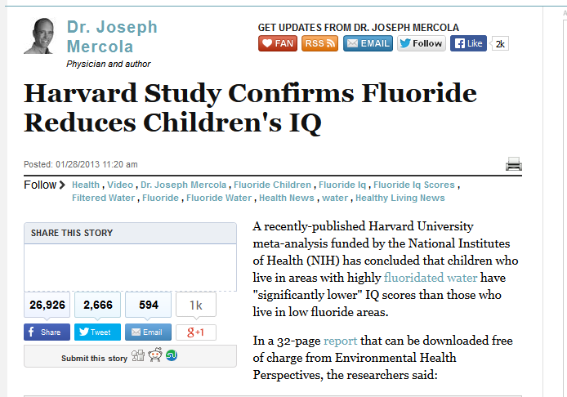

Slide 4
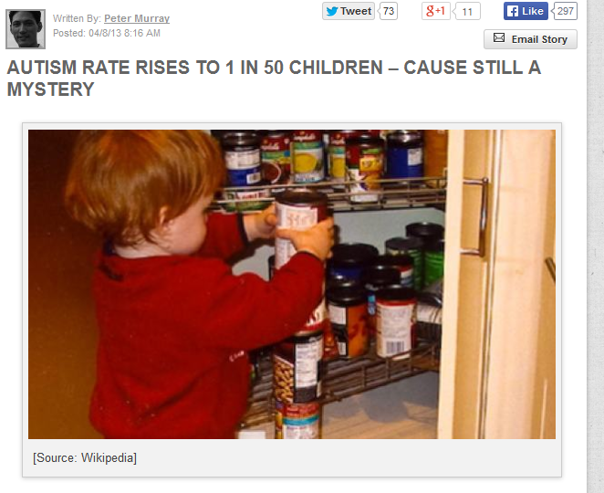
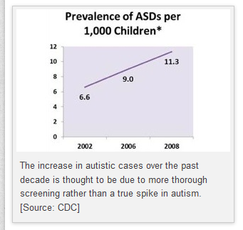

Slide 6
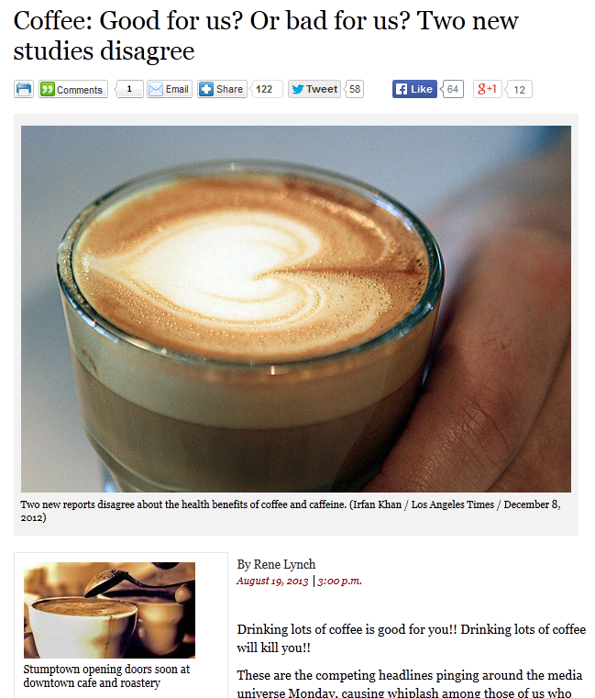
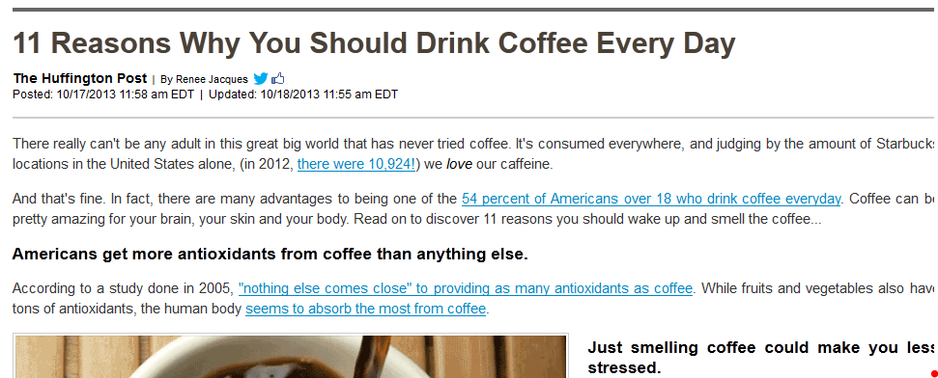
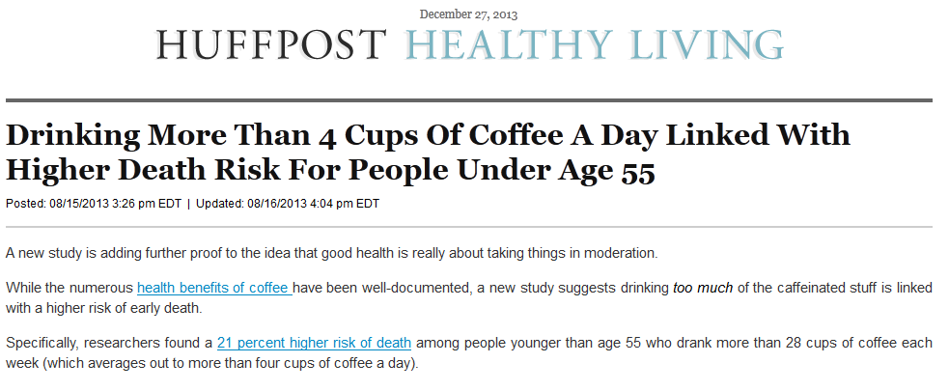

Slide 7
A Primer for Hypothesis Testing
i.e., the last “third” of this course
(and just what do these jokers know about it?)

Slide 8
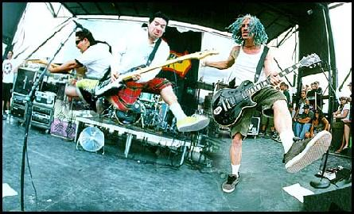

Slide 12
“It's so easy to defend the Status Quo,
with everyone so cool and
cynical.
But when you see the end don't justify the means...
it's just that 180 degrees.”
- NOFX, 180 degrees

Slide 13
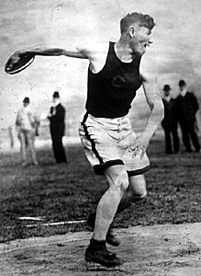
Proof by Contradiction: the heart of Hypothesis Testing
Sit on back whilst we do a little geometry and remember what a proof by contradiction is...
Caffeine and Heart Rate Article

Slide 14
Results
Caffeine at 1.5 and 3.0 mg/kg body weight significantly lowered, by a range of 4 to 7 bpm, HR during all three submaximal exercise intensities compared to placebo
(P < 0.05) but not at rest (P > 0.05) or maximal exercise
(P > 0.05).

Slide 15
“Research” Hypothesis – a belief to be tested using statistical methods...in this case, that caffeine will significantly lower HR during and after certain levels of exercise.
“Null” Hypothesis – the “status quo”… different than (often, the opposite of) the research hypothesis...in this case, that caffeine does not lower HR.
Hypothesis Test – the statistical method(s) used to support either the research or null hypothesis.

Slide 16
“Caffeine significantly lowered HR during all three sub maximal exercise intensities compared to placebo
(P < 0.05) but not at rest (P > 0.05) or maximal exercise (P > 0.05).”
Experimental Group vs. Control Group

Slide 17
“Caffeine significantly lowered HR during all three sub maximal exercise intensities compared to placebo
(P < 0.05) but not at rest (P > 0.05) or maximal exercise (P > 0.05).”
In any experiment, you start by assuming the opposite of what you’re trying to show.
“Assume the null, and then see if the data suggests otherwise.”

Slide 18
“Caffeine significantly lowered HR during all three sub maximal exercise intensities compared to placebo
(P < 0.05) but not at rest (P > 0.05) or maximal exercise (P > 0.05).”
This “P” is called the “P – value”
formal definition:
P(get the data we did or more extreme data, assuming the null hypothesis is true)
In this case…”It’s the chance we got HR lowered at least as much as we did, assuming that caffeine wasn’t doing the lowering.”

Slide 19
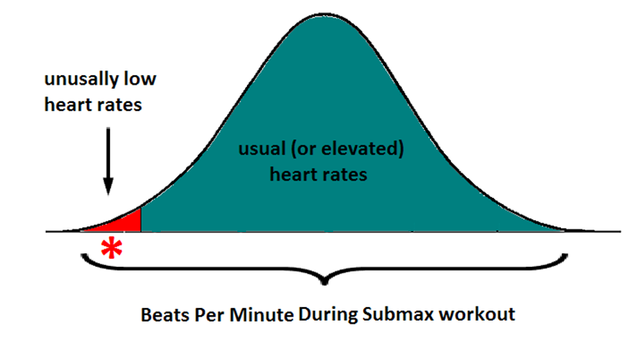
“Caffeine significantly lowered HR during all three sub maximal exercise intensities compared to placebo
(P < 0.05).”

Slide 20
“Caffeine significantly lowered HR during all three sub maximal exercise intensities compared to placebo
(P < 0.05).”
“There’s less than a 5% chance that we should have seen HR lowering data at least this extreme – IF caffeine wasn’t doing the lowering.”

Slide 21
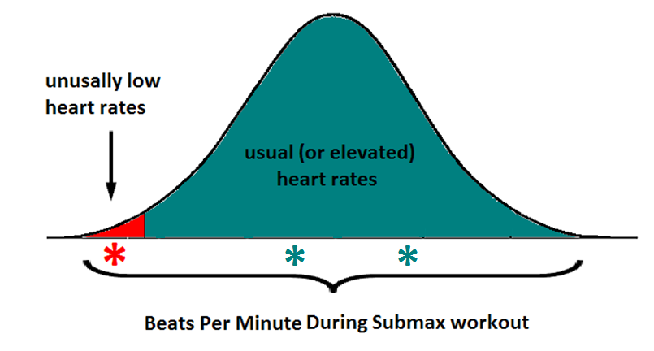
“Caffeine significantly lowered HR during all three sub maximal exercise intensities compared to placebo
(P < 0.05) but not at rest (P > 0.05) or maximal exercise (P > 0.05).”

Slide 22
“Caffeine significantly lowered HR during all three sub maximal exercise intensities compared to placebo
(P < 0.05) but not at rest (P > 0.05).”
“There’s a LARGE (that is, greater than 5%) chance that we could have seen HR lowering data at least this extreme – IF caffeine weren’t doing the lowering.”
“Caffeine significantly lowered HR during all three sub maximal exercise intensities compared to placebo
(P < 0.05) but not at rest (P > 0.05) or maximal exercise (P > 0.05).”
“Again - there’s a LARGE (that is, greater than 5%) chance that we could have seen HR lowering data at least this extreme – IF caffeine weren’t doing the lowering.”

Slide 23
The “big” idea:
Large P – values imply that nothing unusual has happened…in other words, whatever effect you’re studying appears to have had no effect.
“Large” P – values imply that your data falls within ____________________
“Large” P – values are generally those greater than ________________

Slide 24
The “big” idea (continued):
Small P – values imply the opposite…whatever you’re studying had a measurable effect – because it’s too hard to believe that what happened occurred due to randomness and not the effect!
“Small” P – values imply that your data falls outside of ____________________
“Small” P – values are generally those less than ________________
Green tea article...

Slide 25
What is this study trying to show, with respect to green tea and breast cancer? That is, what is the Research Hypothesis (AKA, H₁)?
Therefore, what’s the Null Hypothesis (H₀)?

Slide 26
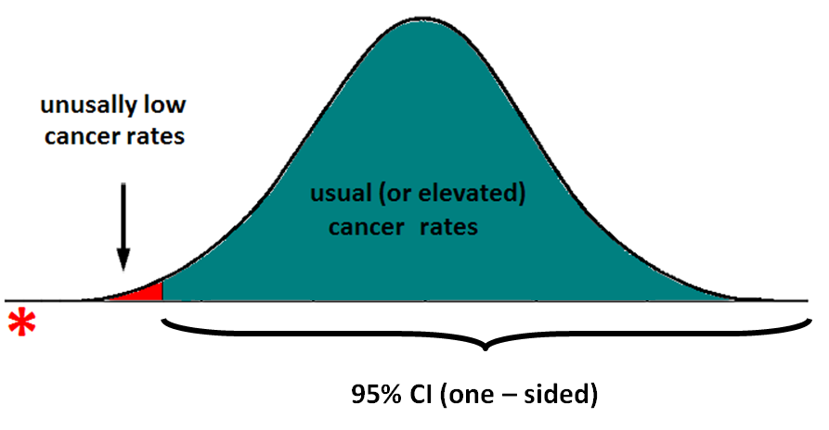
“Green tea consumption was associated with a reduced risk of breast cancer with a statistically significant test for trend (P < 0.001).”

Slide 27
“Green tea consumption was associated with a reduced risk of breast cancer with a statistically significant test for trend (P < 0.001).”
“The chance that we got reduced BC data at least as extremely low as we did, assuming that green tea is not the contributing factor, is less than 1 in 1000.”
Does it appear that green tea is associated with lower rates of breast cancer?

Slide 28
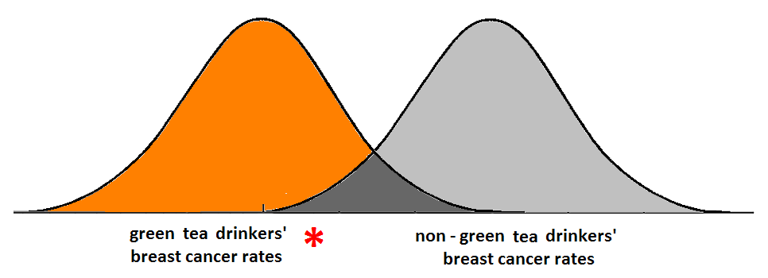
If you observed *, which is more likely: that your results came from the green tea drinkers or non – green tea drinkers?

Slide 30
Measurements and Main Results
At 0 to 1 hour (time of initial SHS exposure) most lung function parameters were significantly reduced (P < 0.05), but at 3 hours they were at baseline levels (P > 0.05).

Slide 31
Measurements and Main Results
At 0 to 1 hour (time of initial SHS exposure) most lung function parameters were significantly reduced (P < 0.05).
H₀ ?
H₁ ?

Slide 32
Measurements and Main Results
At 0 to 1 hour (time of initial SHS exposure) most lung function parameters were significantly reduced (P < 0.05).
Does SHS appear to affect lung function from 0 to 1 hour?
Could we be wrong? How?

Slide 33
“At 0 to 1 hour (time of initial SHS exposure) most lung function parameters were significantly reduced (P < 0.05), but at 3 hours they were at baseline levels (P > 0.05).”
H₀ ?
H₁ ?

Slide 34
“At 0 to 1 hour (time of initial SHS exposure) most lung function parameters were significantly reduced (P < 0.05), but at 3 hours they were at baseline levels (P > 0.05).”
Does SHS appear to affect lung function after 3 hours?
Could we be wrong? How?

Slide 35
Ways to be wrong with Hypothesis Tests!
If…
…you get a small P – value…
…the common response is “something changed!”
What’s the chance that you’re wrong?

Slide 36
Ways that Hypothesis Tests can Unfold
Ways to be wrong with Hypothesis Tests!
If…
…you get a small P – value…
…the common response is “something changed!”
P(false positive) = P(Type I Error) = α…usually 5%

Slide 37
Ways that Hypothesis Tests can Unfold
Ways to be wrong with Hypothesis Tests!
In the SHS article…
“At 0 to 1 hour (time of initial SHS exposure) most lung function parameters were significantly reduced (P < 0.05).”
Define this Type I error…in context.

Slide 38
Ways that Hypothesis Tests can Unfold
Ways to be wrong with Hypothesis Tests!
If…
…you get a large P – value…
…the common response is “nothing changed.”
What’s the chance that you’re wrong?

Slide 39
Ways that Hypothesis Tests can Unfold
Ways to be wrong with Hypothesis Tests!
If…
…you get a large P – value…
…the common response is “nothing changed.”
P(false negative) = P(Type II Error) = β

Slide 40
Ways that Hypothesis Tests can Unfold
Ways to be wrong with Hypothesis Tests!
In the SHS article…
At 3 hours, most lung function parameters were not reduced
(P > 0.05).
Define this Type II error…in context.

Slide 41
The takeaway about error (more to come):
If you get a small P – value and react appropriately, you could make a Type I error (with probability α).
If you get a large P – value and react appropriately, you could make a Type II error (with probability β).

Slide 42
