Slide 1
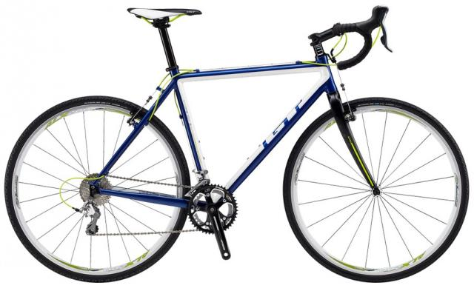

Slide 2
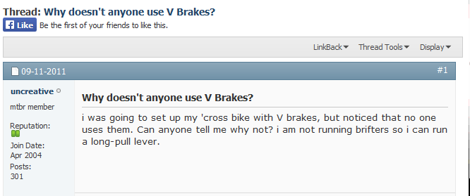
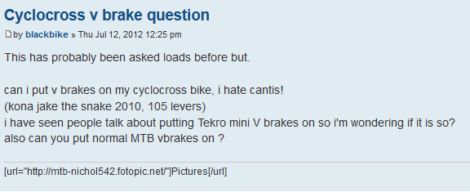
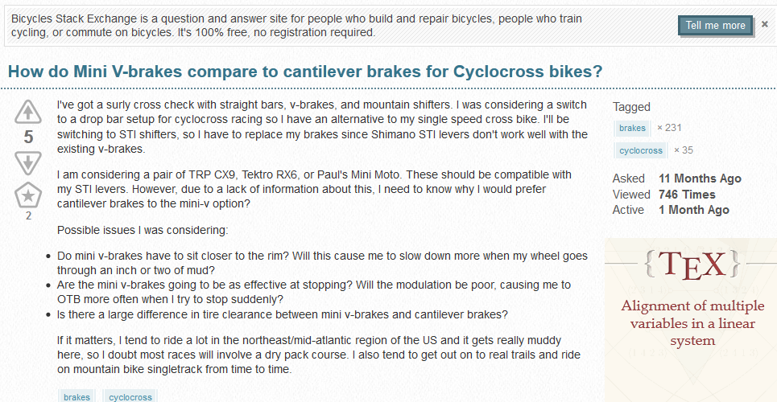
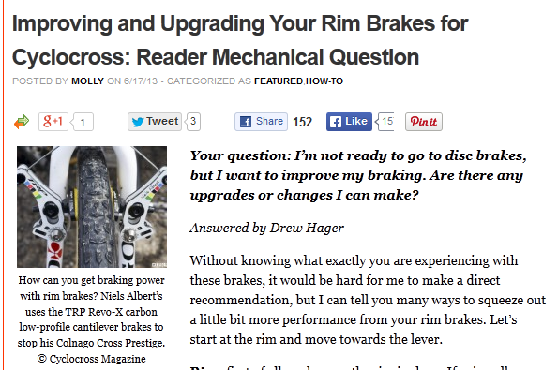

Slide 3
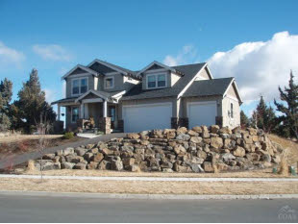
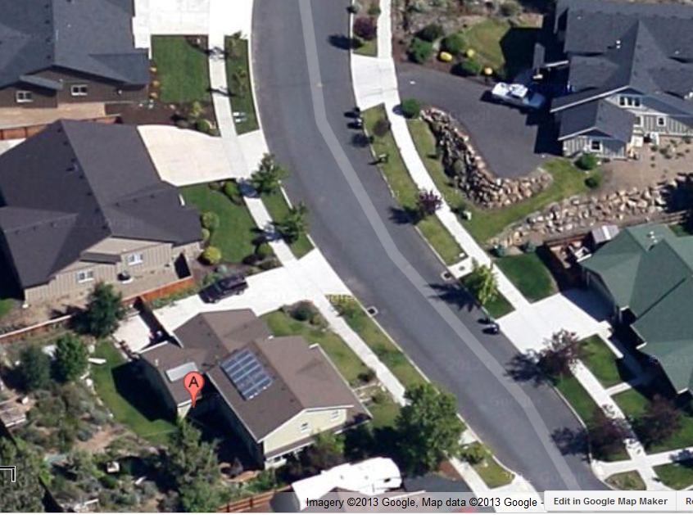
Methodology

Slide 4
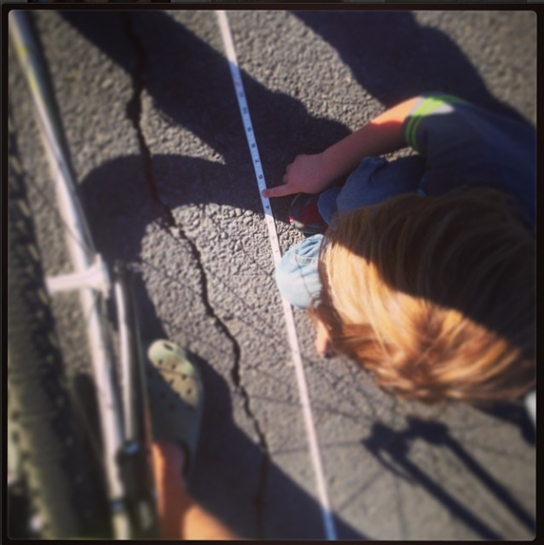

Slide 5
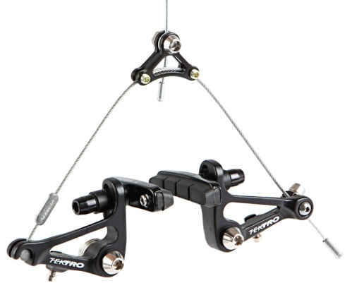
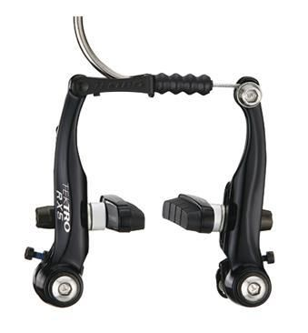
Results (in feet)
Before (cantilever)
21.1 | 23.4 | 24.6 | 19.8 | 23.9 | 25.6
20.3 | 21.9 | 23.5 | 23.9 | 24.2
20.2 | 19.4 | 21.4 | 27 | 22.4
23.8 | 23.5 | 26.5 | 24.8 | 22.7
After (linear pull “V”)
16.9 | 16.2 | 15.8 | 18.7 | 15.9
14.3 | 16.4 | 17.5 | 18.4 | 15.1
15.8 | 16.1 | 16.3 | 16.8 | 16.3
16 | 17.3 | 15.2 | 17.6 | 14.8

