Slide 1
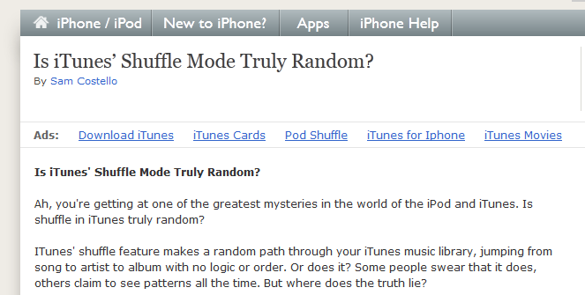
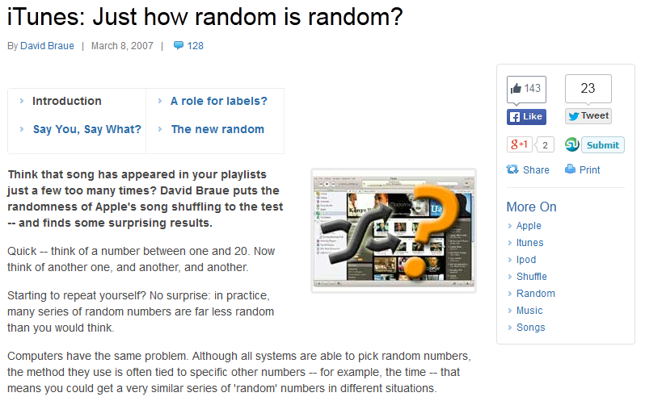
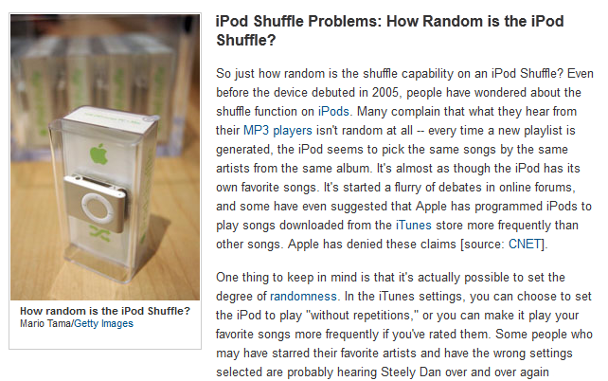
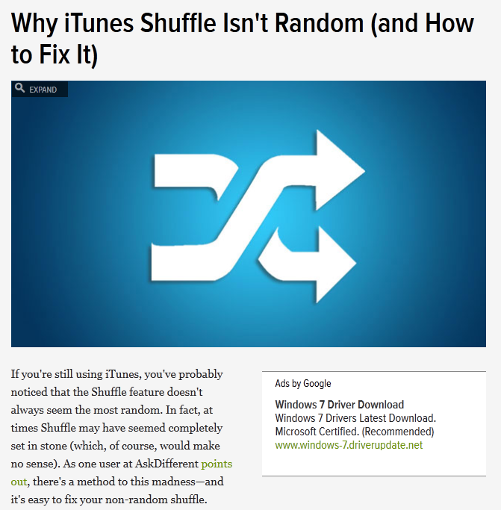

Slide 2


Slide 3
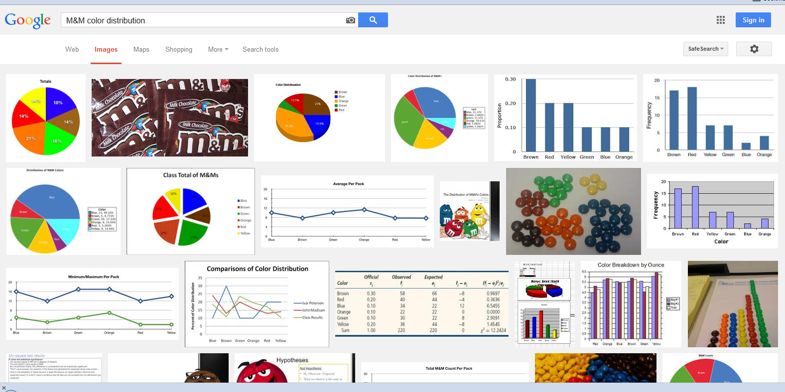
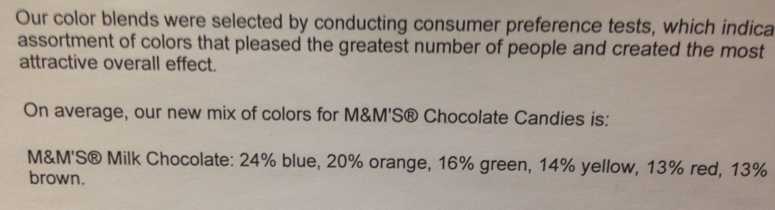

Slide 5
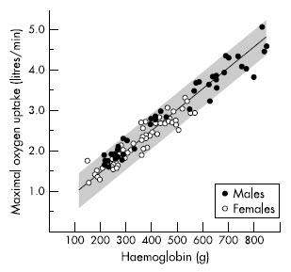

Slide 6
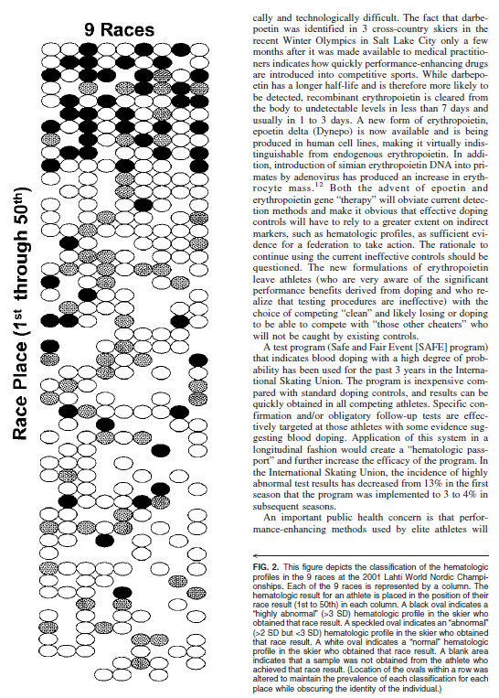

Do we think athletes are using?
2001 Nordic World Championships
50th
1st
Expected values
0.3%
2.5%
97.5%
Actual values
17%
19%
64%
Stray-Gunderson et al., 2003, Clin J of Sprt Med

Slide 7
Does Testing work?
Lundby et al., 2008, JAP

Slide 8
Does Testing work?
Lundby et al., 2008, JAP

